Slide 1
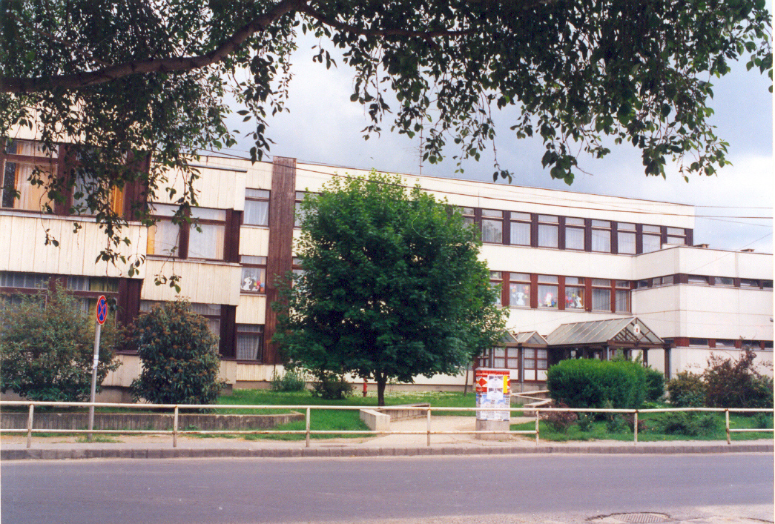
Kardos István Primary School and Economical Grammar School

Slide 2
Lower school
15 classes
392 students
Day nursery groups: 14

Slide 3
Specializations of our classes

Slide 4
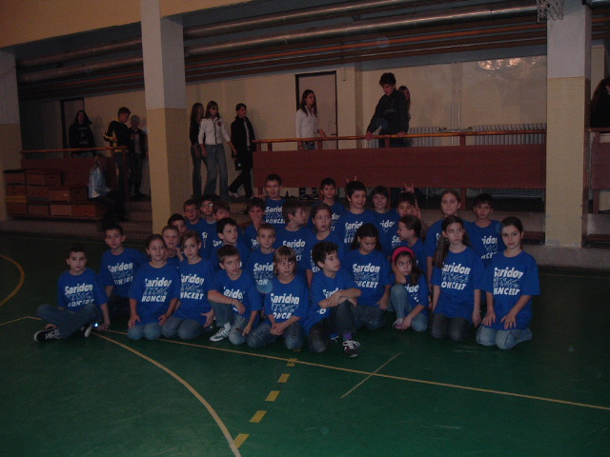
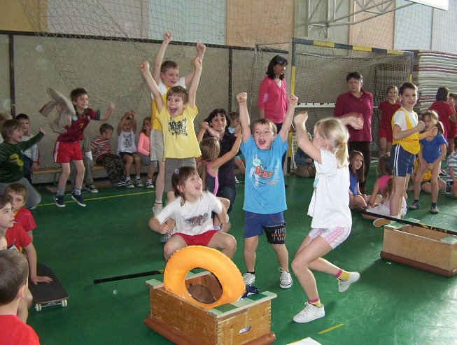
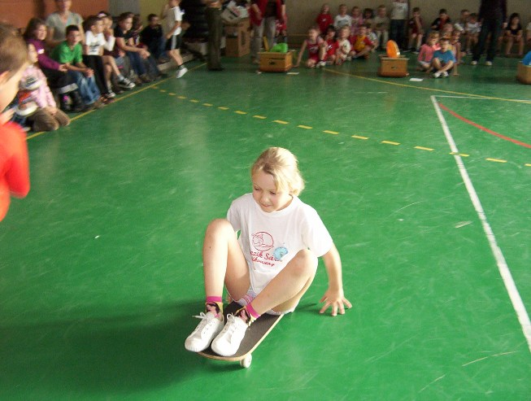
Class with a special curriculum
Handball
Footballing
Basketball
Spongeball
Dancing

Slide 5
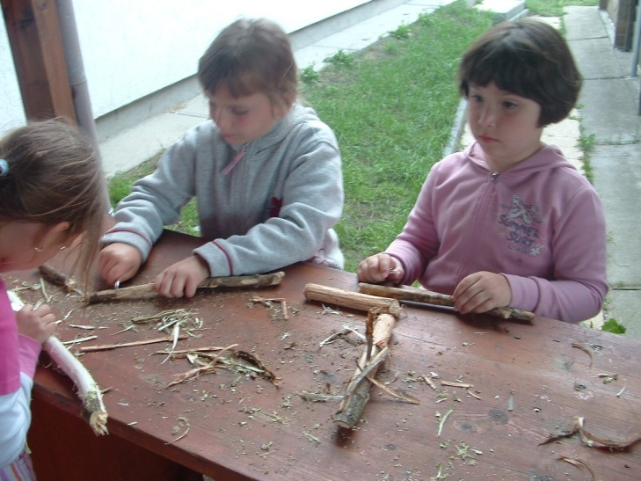
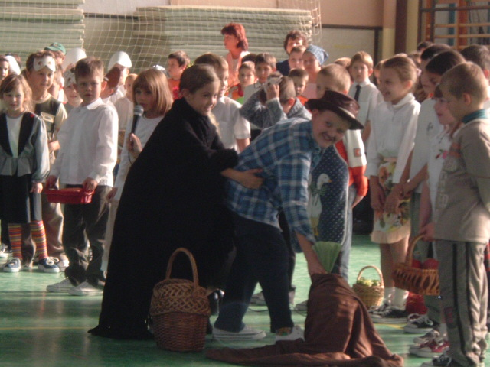
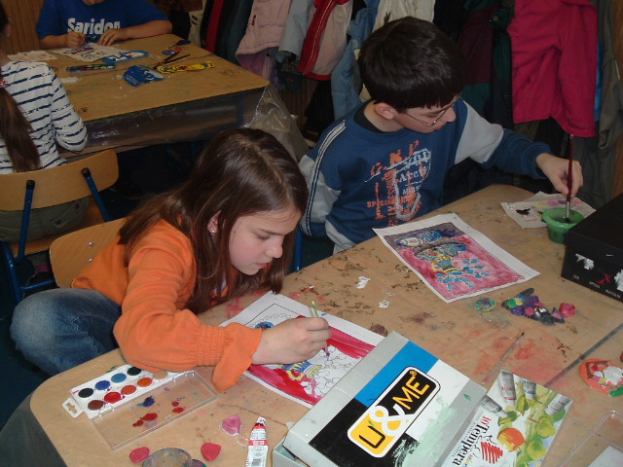
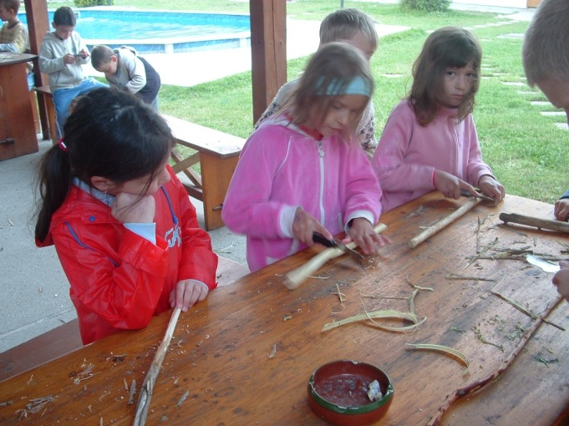
Creative- hand craft
Playful teamwork

Slide 6
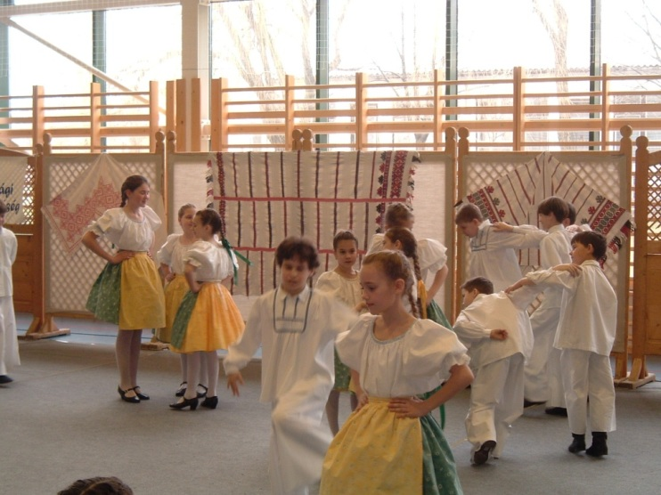
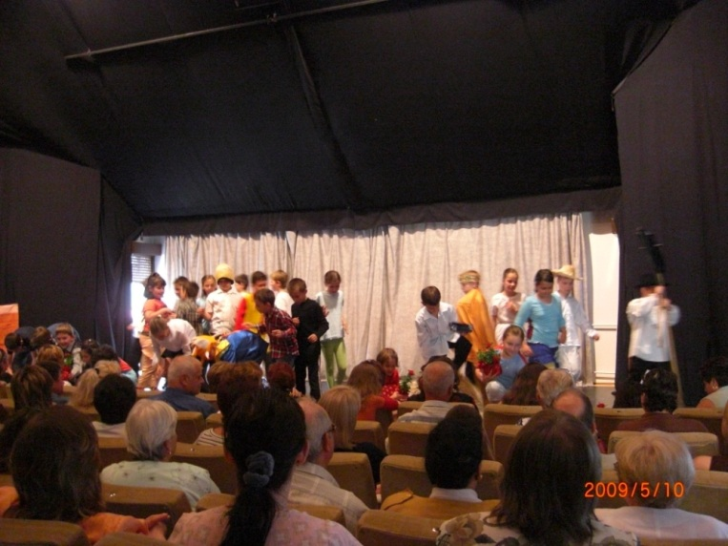
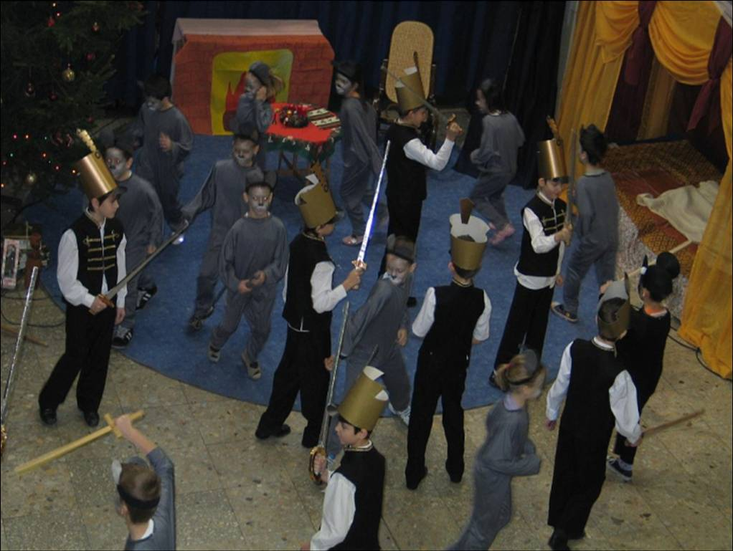
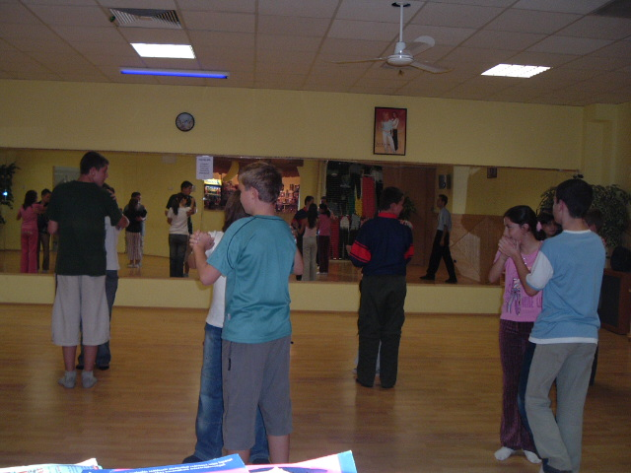
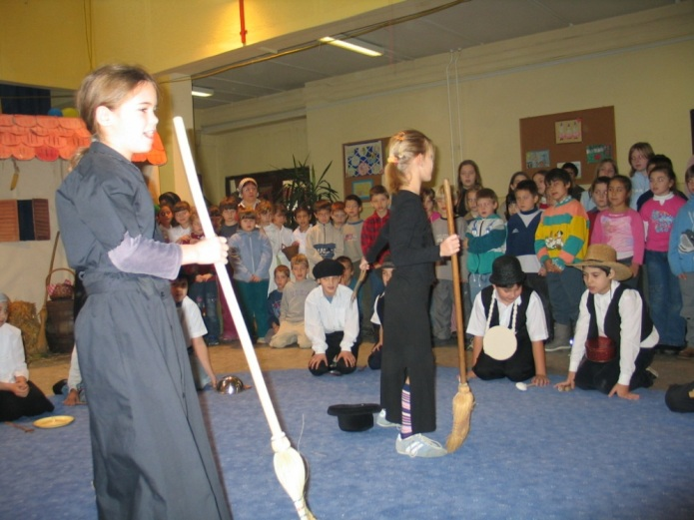
Artistic class
Dancing
Performing

Slide 7
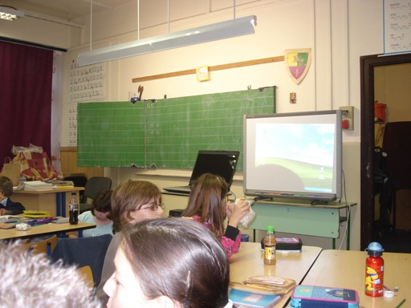
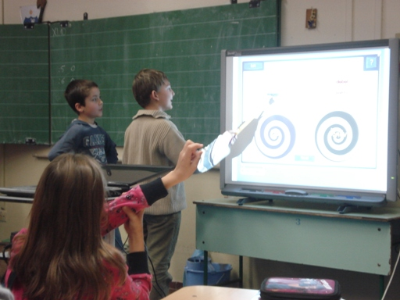
ENGLISH- I.T
Possibility of learning foreign language in playful way
Learning with computers

Slide 8
Developing talented students

Slide 9
Study groups
Chorus
Artistic
Maths
Folk dancing
Playful Maths
Hand craft
Table tennis
Swimming….

Slide 10
Our annual programmes

Slide 11
Our offering is very rich…
Fruit market
Playing with kindergartener
Competitions of Kardos week
Santa Claus celebration
Luca market
Mothers’ day
Local competition of Hungarian language
Hungarian Folklor
Open days, when parents, kindergarteners can visit lessons
Schools in the forest
Obstacle race

Slide 12
Creating community..

Slide 13
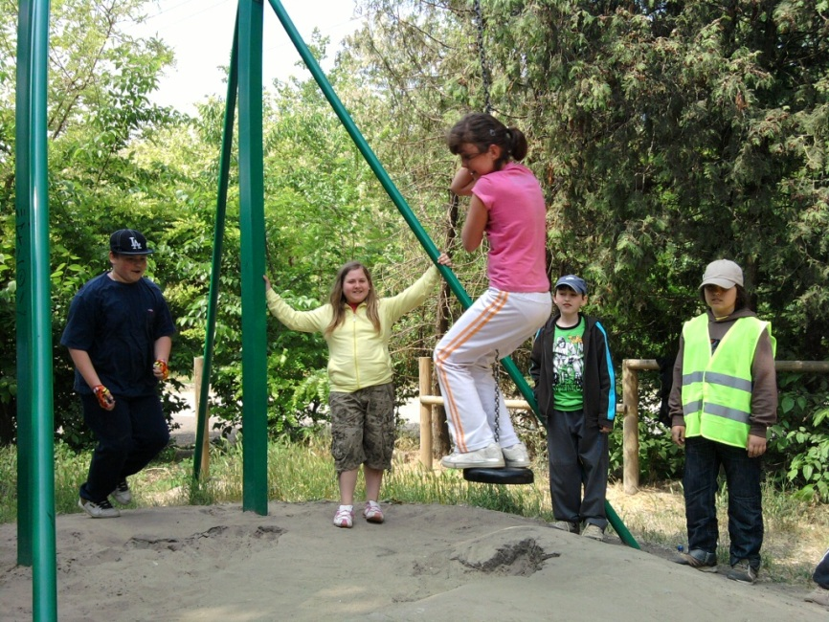
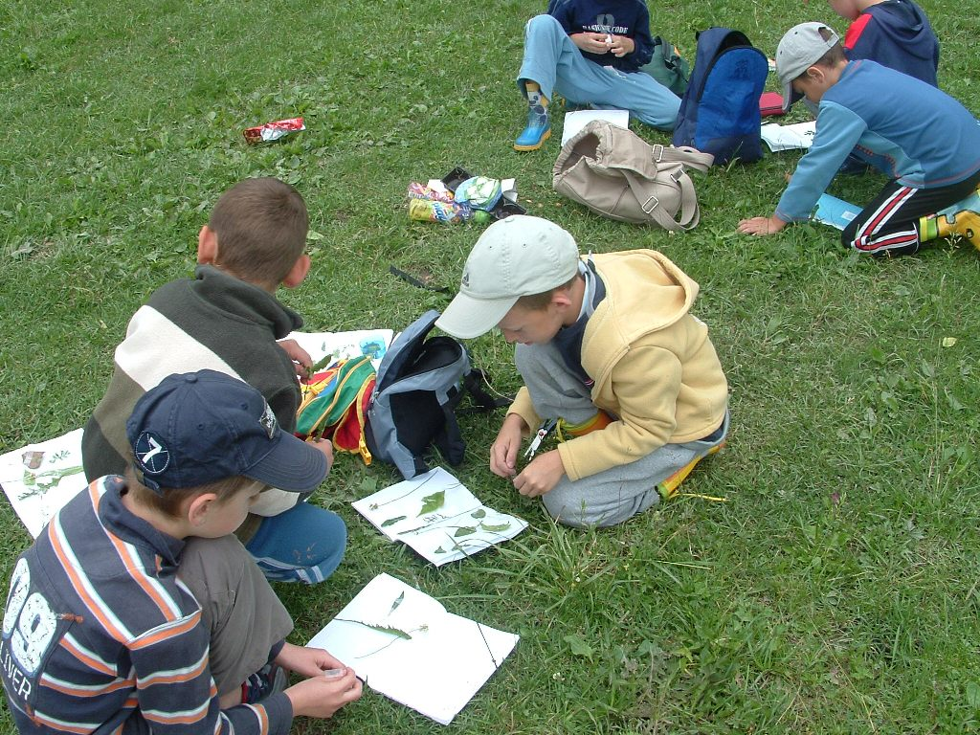
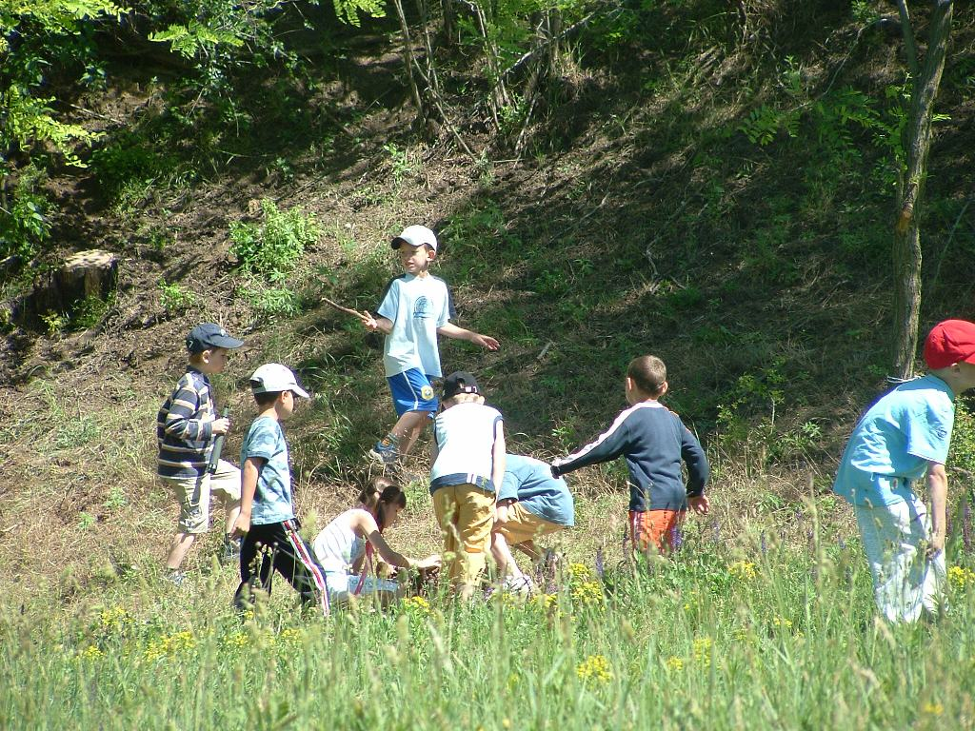
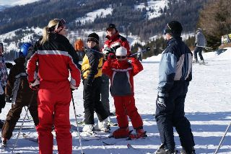
Excursions, sports

Slide 14
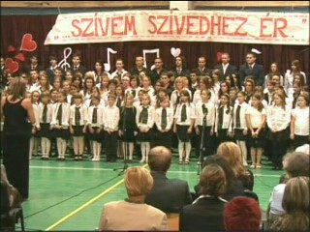
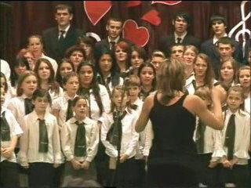
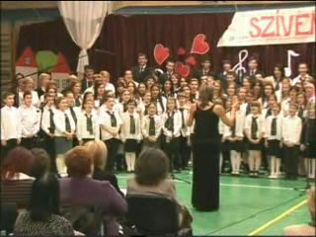
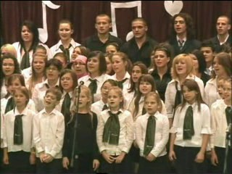
Chorus

Slide 16
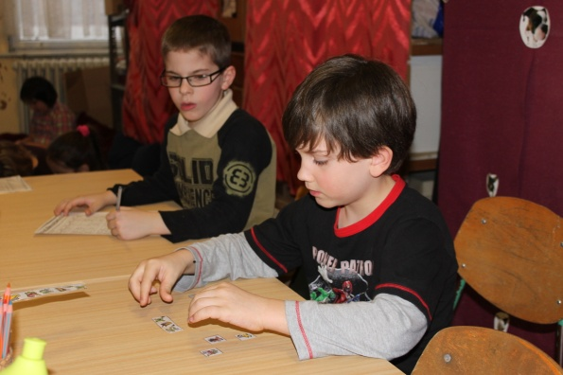
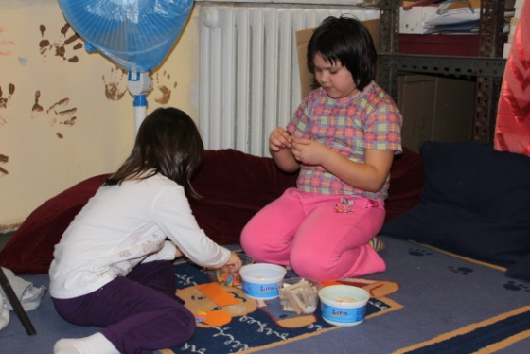
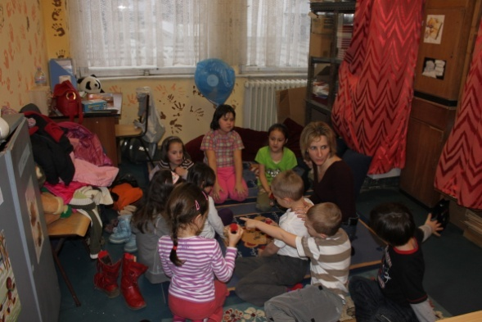
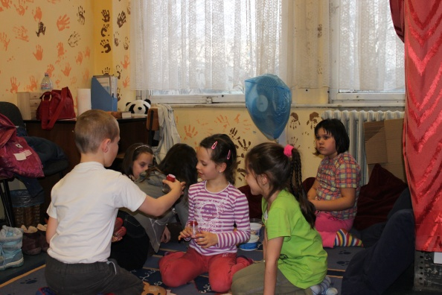
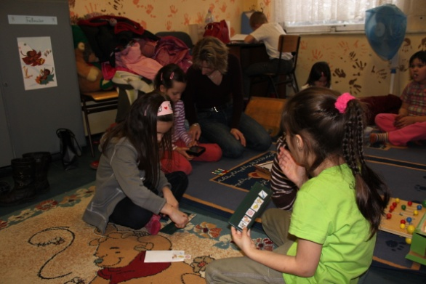
www.kardosiskola.hu

