Slide 1

From Farm to Fork
P.O.C.K.E.T

Slide 2
What is Farming?
Section 1:

Slide 3
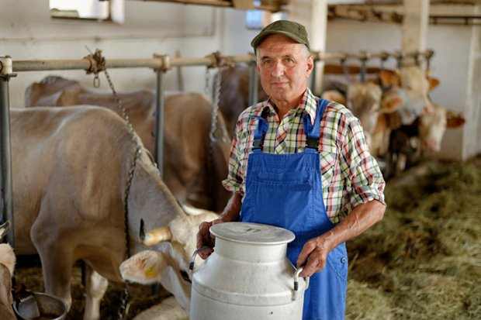
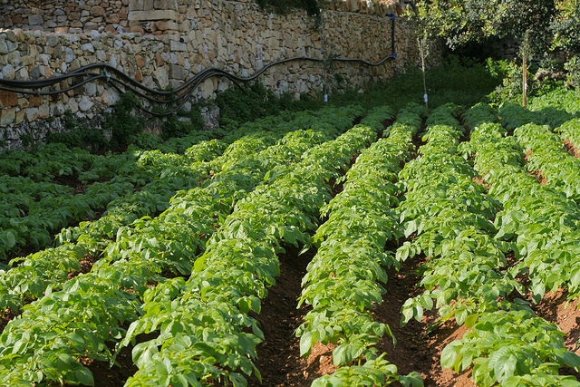
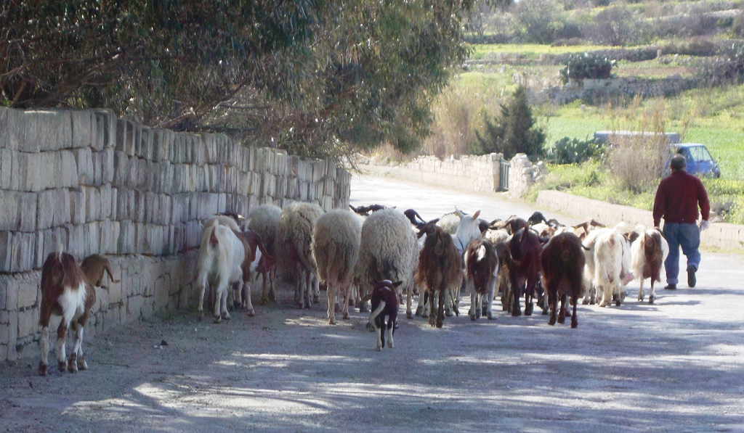
Farming is the process producing crops or raising of animals for human consumption.

Slide 4
Farming could be divided into 5 sectors:
Intensive
Semi-Intensive
Extensive
Mixed Farming
Organic

Slide 5
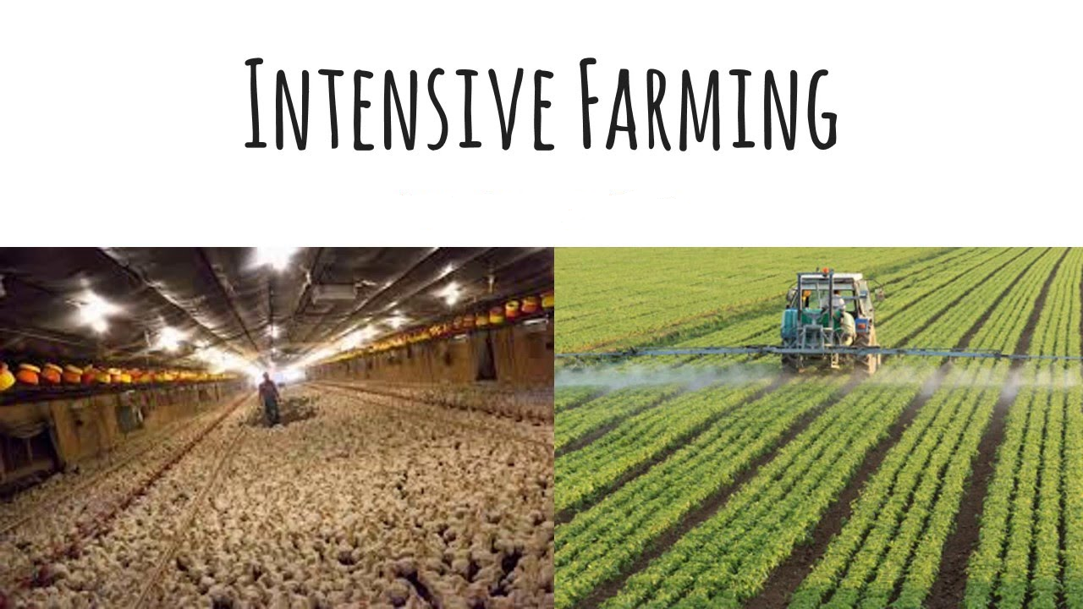
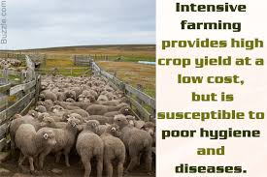
Intensive Framing:
It is also referred to as intensive agriculture or factory farming.
It is a kind of agriculture where a lot of money and labour are used to increase the yield that can be obtained per area of land.
It involves the use of large amounts of pesticides for crops, and of medication for animal stocks.

Slide 6
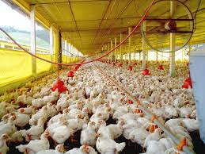
Semi-Intensive Farming:
This is when all the animals are bread and kept indoor but can go out side.
All animals are still normally given medication and farms are of an industrial scale.

Slide 7
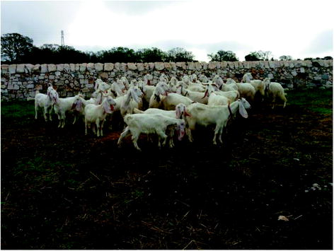
Extensive Farming:
It is the opposite of Intensive farming.
It uses traditional methods of farming where less technology is used.
Animals are given natural food and are kept outdoors.

Slide 8
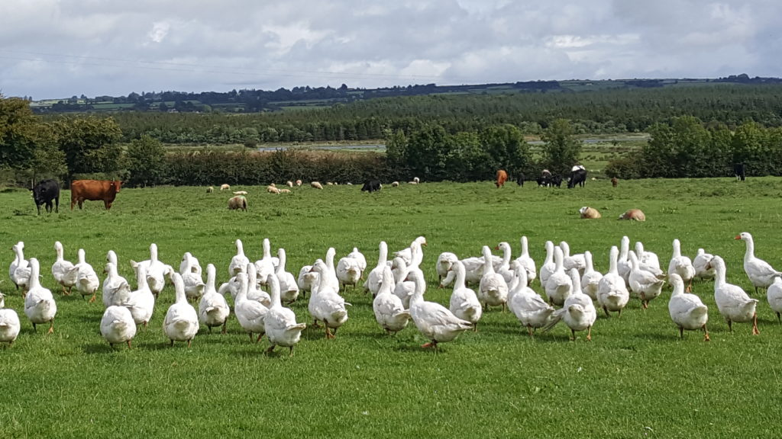
Mixed Farming:
It involves both the growing of crops as well as the raising of livestock on the same farm.
It is a form of sustainable farming as farmers grow both crops to sell as well as to feed their livestock.
Farm animals also provide fertilizer for the farm, help farmers on the fields by pulling ploughs and help them transport crops to the local market.

Slide 9
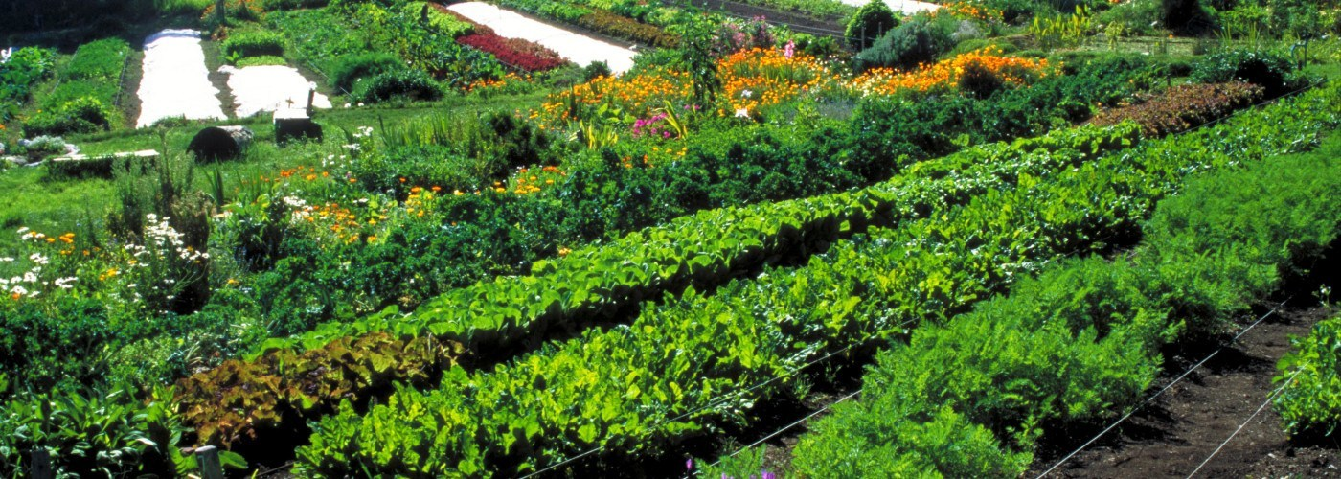
Organic Farming:
Organic Framing is the production of crops and livestock without the use of synthetic chemicals and in-organic fertilizers.
It always existed from the beginning of time, starting off with Cave men, Romans, Egyptians, Barbarians…..
Nowadays it aims for a healthy human life.

Slide 10
What is Organic
Farming?
Section 2:

Slide 11
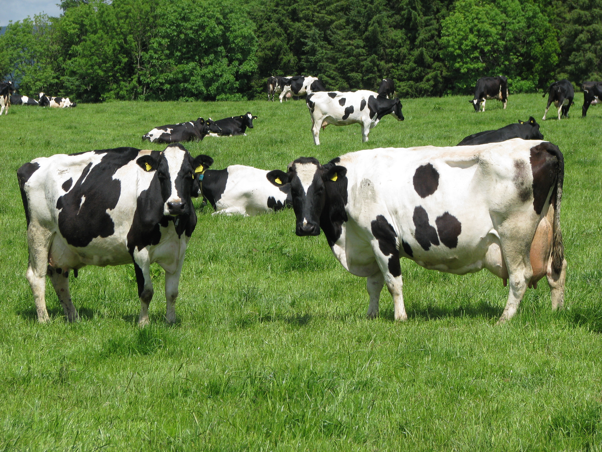
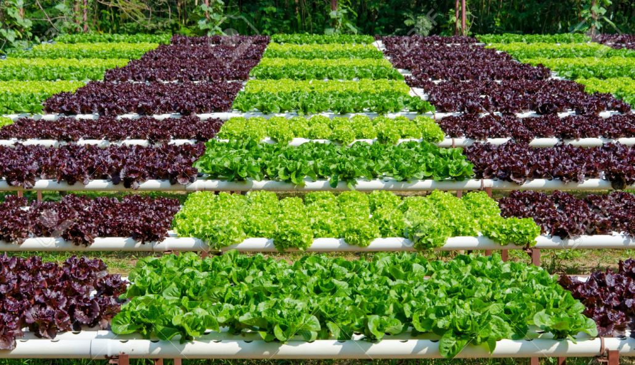

What is Organic?
Examples of Organic Animal and Crop Farming
The Organic Food Label

Slide 12
Principles of Organic Farming:
Wide crop rotation as a prerequisite for an efficient use of on-site resources.
Very strict limits on chemical synthetic pesticide and synthetic fertiliser use, livestock antibiotics, food additives and processing aids and other inputs.
Absolute prohibition of the use of genetically modified organisms.
Taking advantage of on-site resources, such as livestock manure for fertiliser or feed produced on the farm.
Choosing plant and animal species that are resistant to disease and adapted to local conditions.
Raising livestock in free-range, open-air systems and providing them with organic feed.
Using animal husbandry practices appropriate to different livestock species.

Slide 13
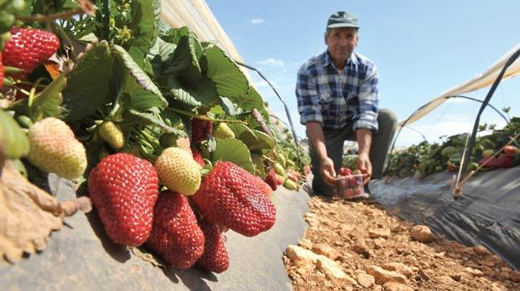
Dealing with Organic Farming:
Keep in mind that welfare of the animals are kept to standard by natural remedies and food.
When dealing with crops one has to keep in mind that crops have to be all naturally grown without any forms of technology.
There is no harm in anyway to humans or wildlife.

Slide 14
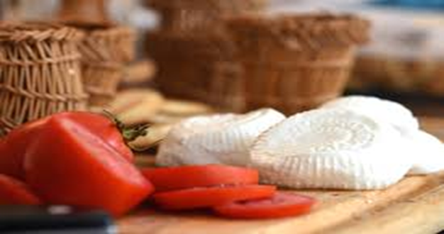
Organic
Local Cheeselets
Section 3:

Slide 15
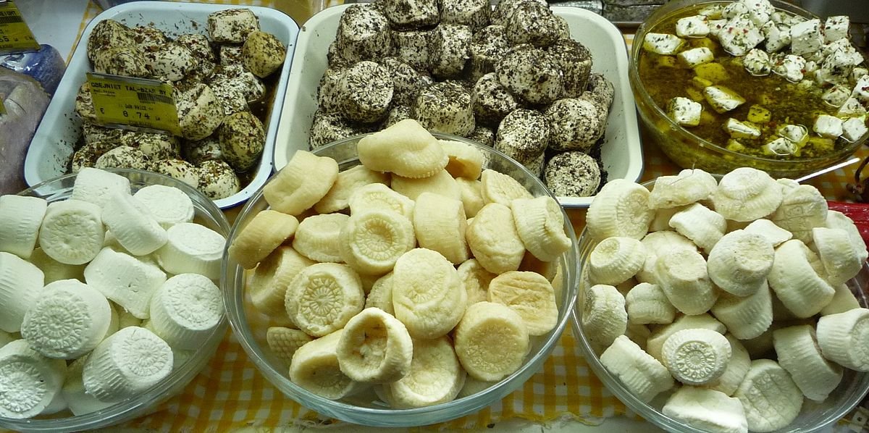
Maltese Organic Local Cheeselets:
Maltese Cheeselets also known as ‘ġbejna’ or in colloquial Maltese ‘ġibna’.
A traditional cheese product of the Maltese island.
They made from goat’s or sheep’s milk.
They come in different flavors and are used in Maltese traditional dishes.

Slide 16
In both Malta and Gozo much of the sheep and goat’s milk is used for the production of these cheeselets, most of it through family owned cottage industries they are prepared and served in a variety of ways:
Pickled
Salted
Peppered
Covered in herbs
Fresh

Slide 17
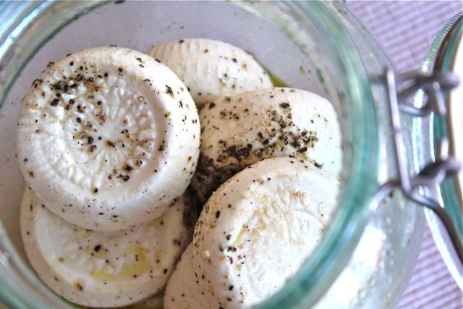
Pickled Cheeselets:

Slide 18
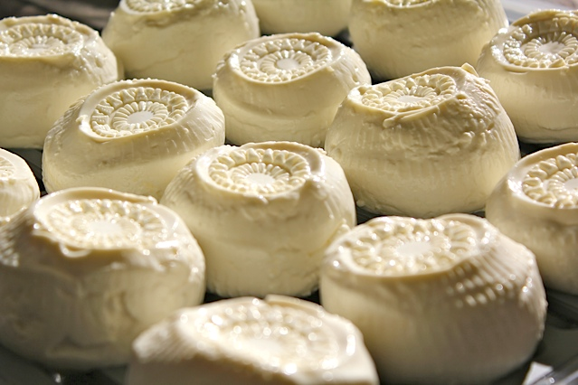
Salted Cheeselets:

Slide 19
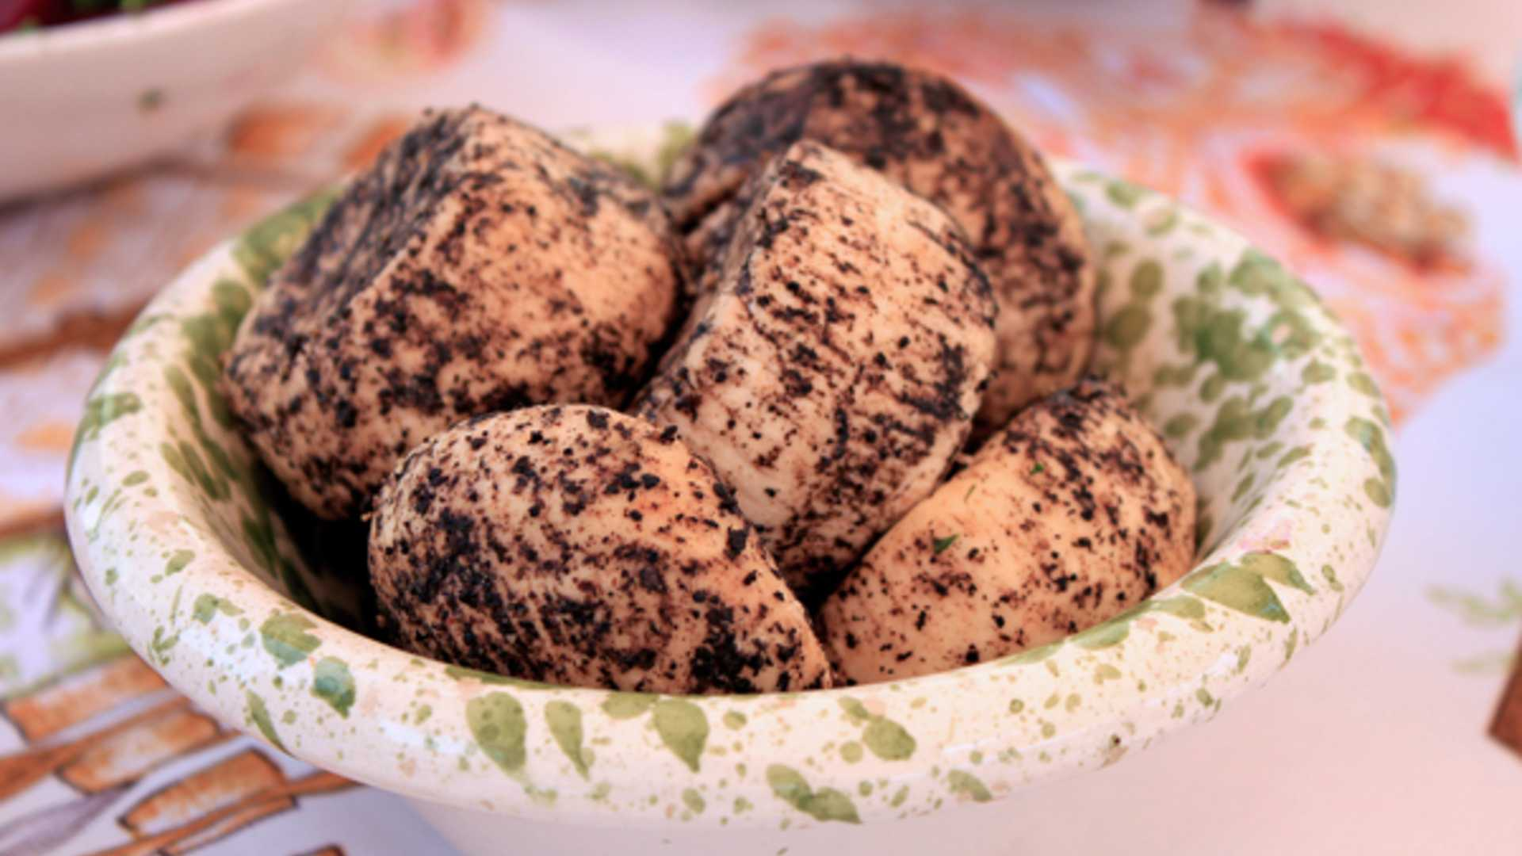
Peppered Cheeselets:

Slide 20
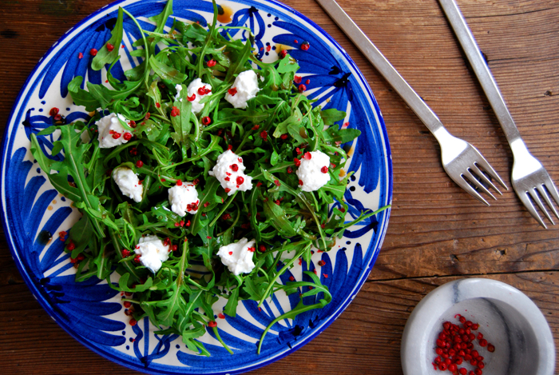
Cheeselets covered in Maltese Herbs:

Slide 21
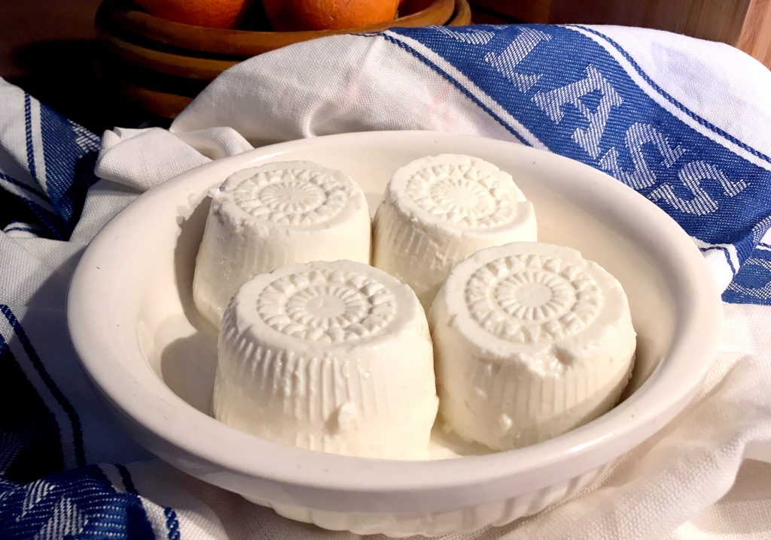
Fresh Cheeselets:

Slide 22
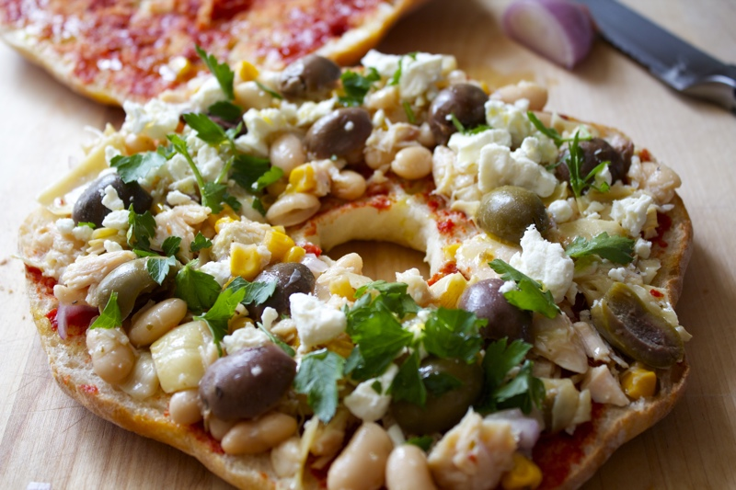
Maltese Cheeselets are used as an ingredient in traditional dishes:
Cheeselets are used as an ingredient in
Maltese traditional
‘Ħobż biż-żejt’

Slide 23
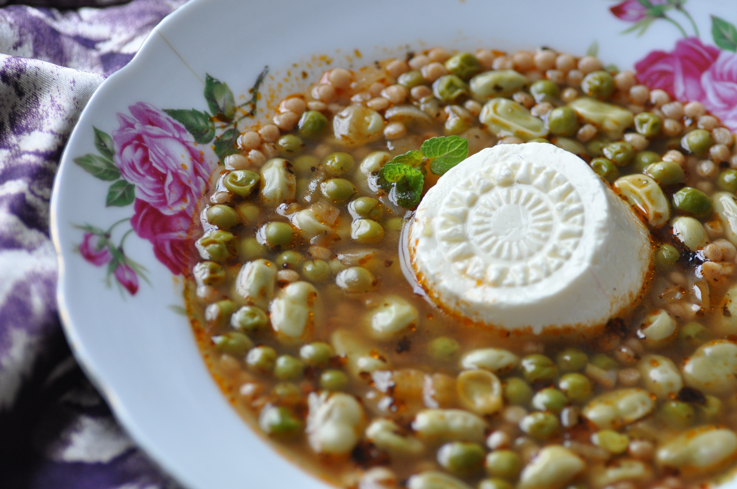
Cheeselets are used as an ingredient in
Maltese traditional
Minestrone Soup known as ‘Kusksu’.

Slide 24
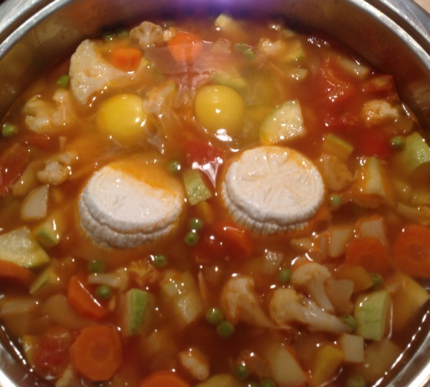
Cheeselets are used as an ingredient in
Maltese traditional
Widow’s Soup known as ‘Soppa tal-armla’.

Slide 25
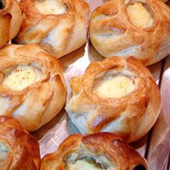
Cheeselets are used as an ingredient in
Maltese traditional cheese Qassatati.

Slide 26
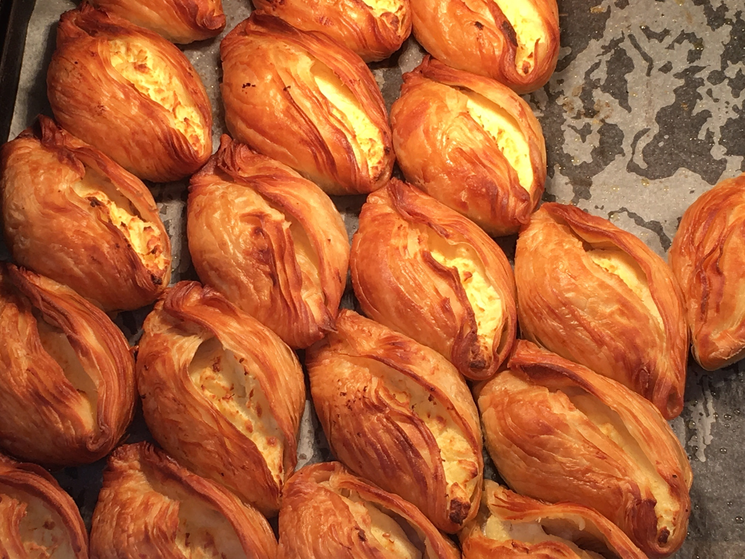
Cheeselets are used as an ingredient in
Maltese traditional cheese Pastizzi.

Slide 27
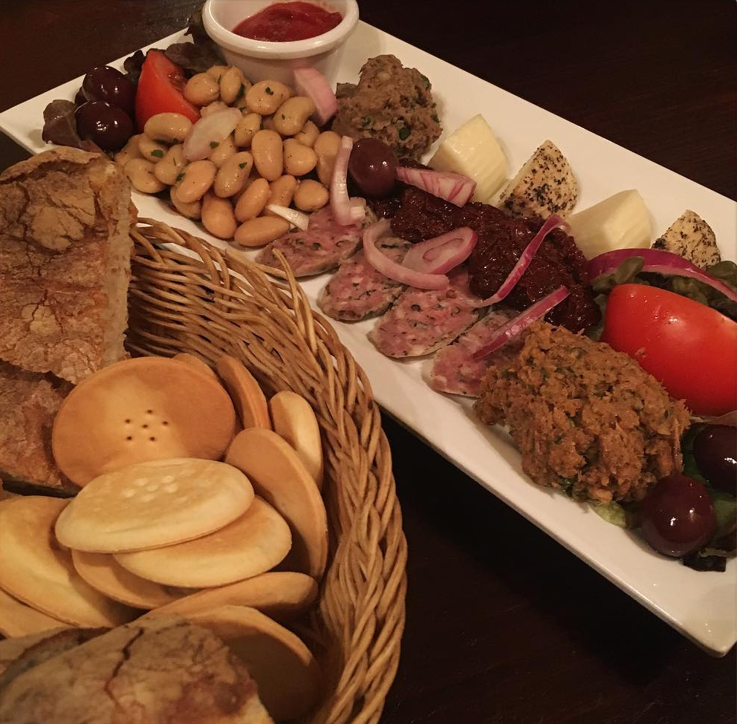
Cheeselets served as an appetizer served with traditional water biscuits known as ‘Galletti’.

Slide 28
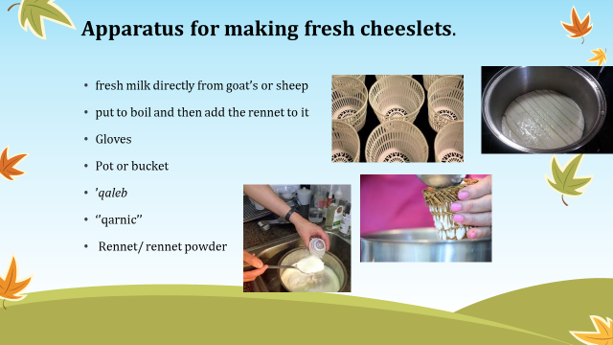

Slide 29
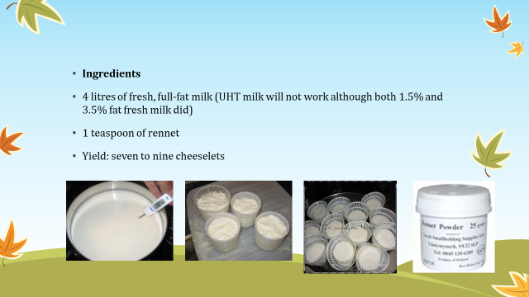

Slide 30
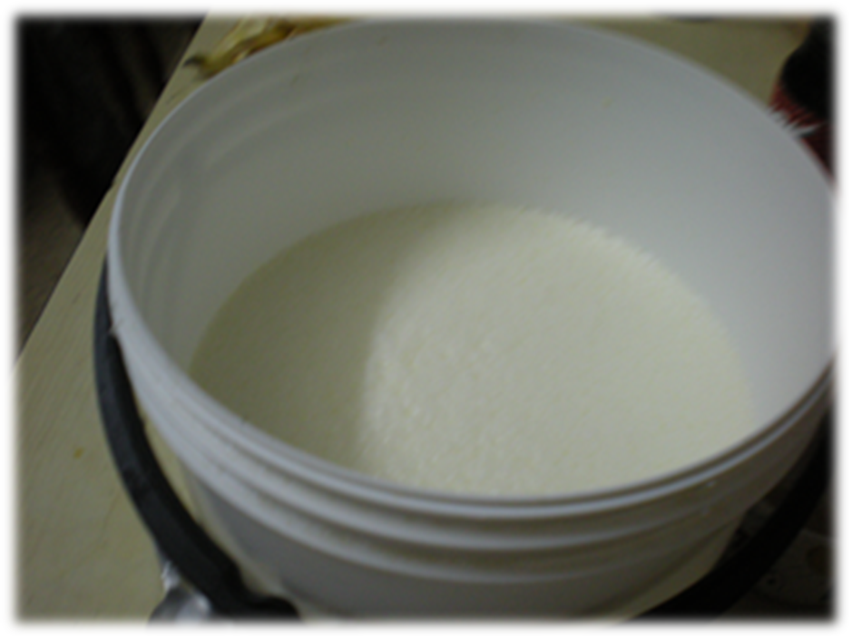
The Process of making traditional fresh Cheeselets:
Fresh goat’s or sheep’s milk is poured in a bucket and sieved.
It is then brought to boil and rennet is added to it.
When ready the mixture is left to rest for about half an hour to form a curd.

Slide 31
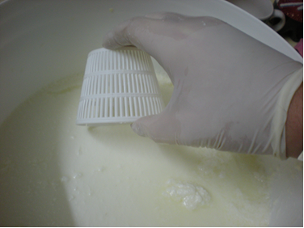
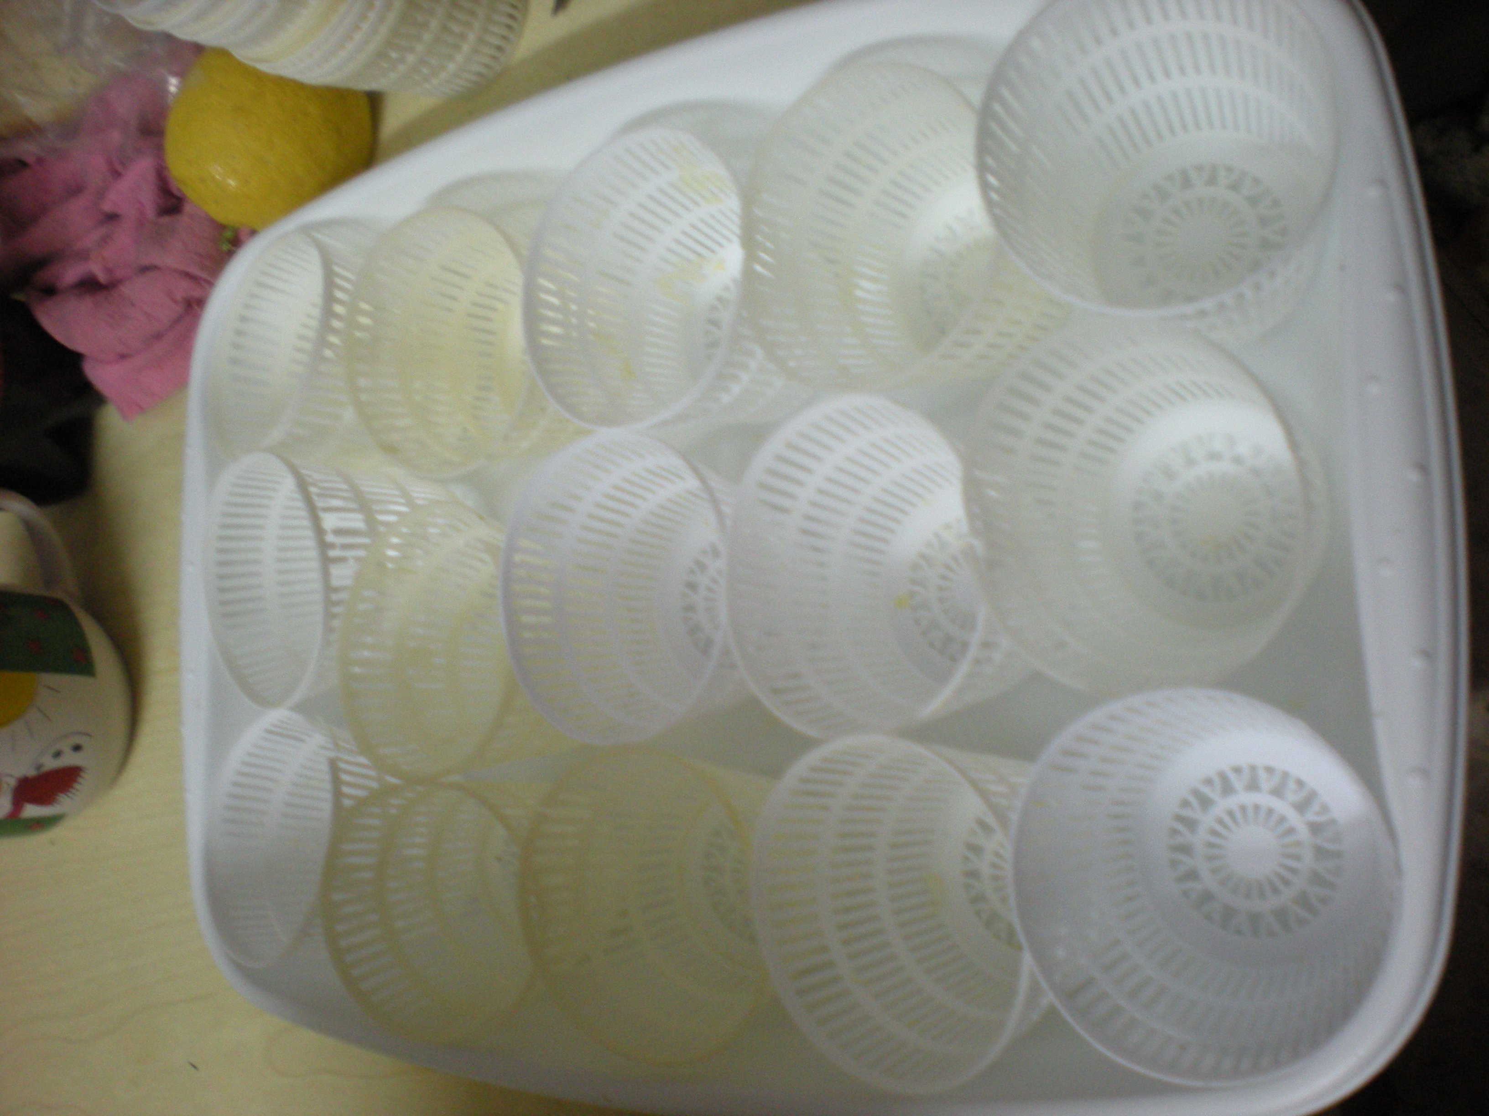
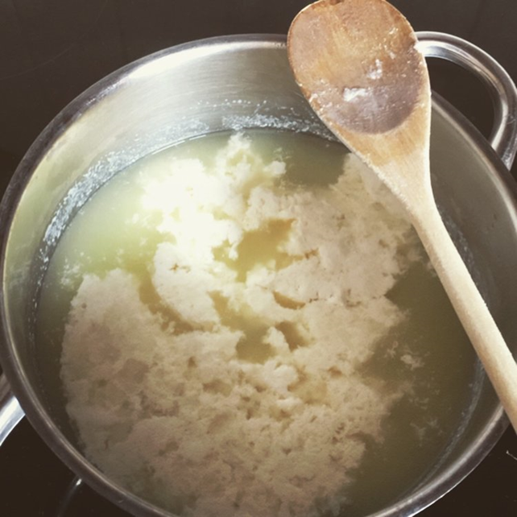
The bulky cheese is then gently placed in special containers called ‘qaleb’.
This is left for about 10 min and the cheeselet is rotated.
‘Qwieleb’ these are sterilised containers to place in the cheeselets.

Slide 32
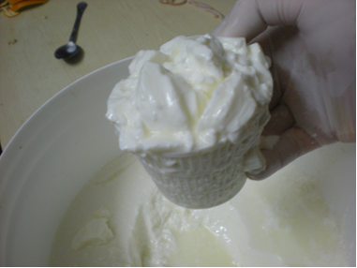
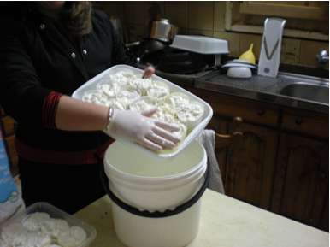
‘Xorrox’ is then separated from the cheese as it is of no more use.
The cheeselets are placed in ‘qwieleb’ to rest.

Slide 33
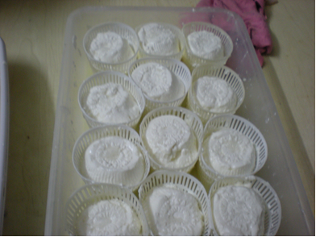
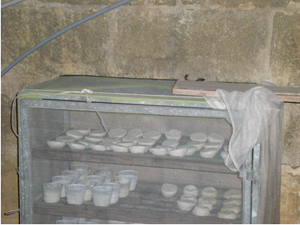
Salt is then sprinkled on top of the fresh cheeselets.
The fresh cheeselets are placed in a special airing cupboard called ‘qarniċ’ to dry up.
This is the ‘Qarniċ’, an airing cupboard which is surrounded by a metal net. It is placed in a sunny spot so that the cheeselets can dry up naturally in the sun.

Slide 34
How its made
https://www.youtube.com/watch?v=RxXjATUX6HM

Slide 35
Qassatati made from
Organic Cheeselets
Section 4:

Slide 36
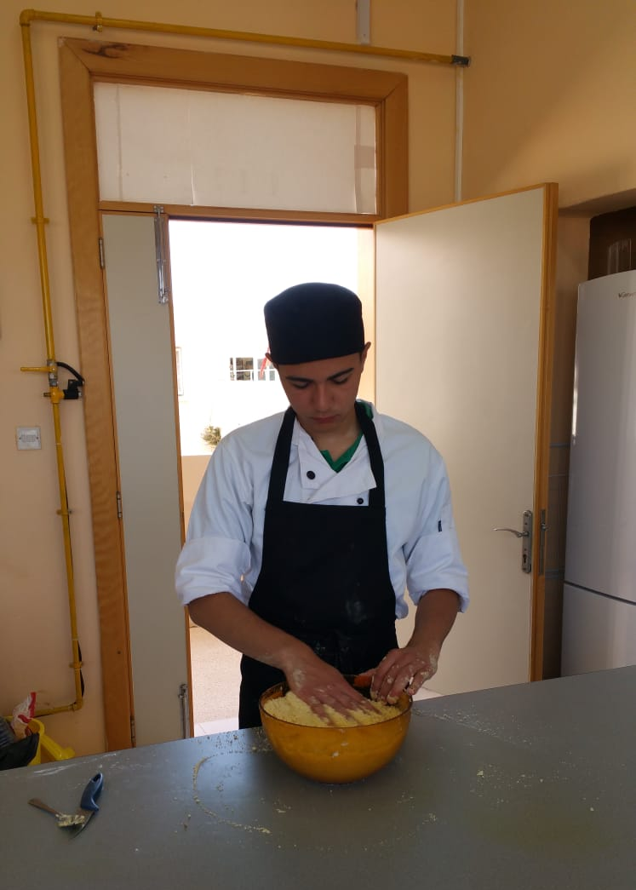
Qassatat Ingredients:
Filling:
500g goats cheeselets
500g ricotta cheese
1 egg yolk
Salt and pepper
Method:
Drain cheeselets well by using a clean cloth and squeezing the access water.
In a large bowl add the cheeselets to the ricotta, egg yolk, salt and pepper.
Put in the fridge until ready to use.

Slide 37
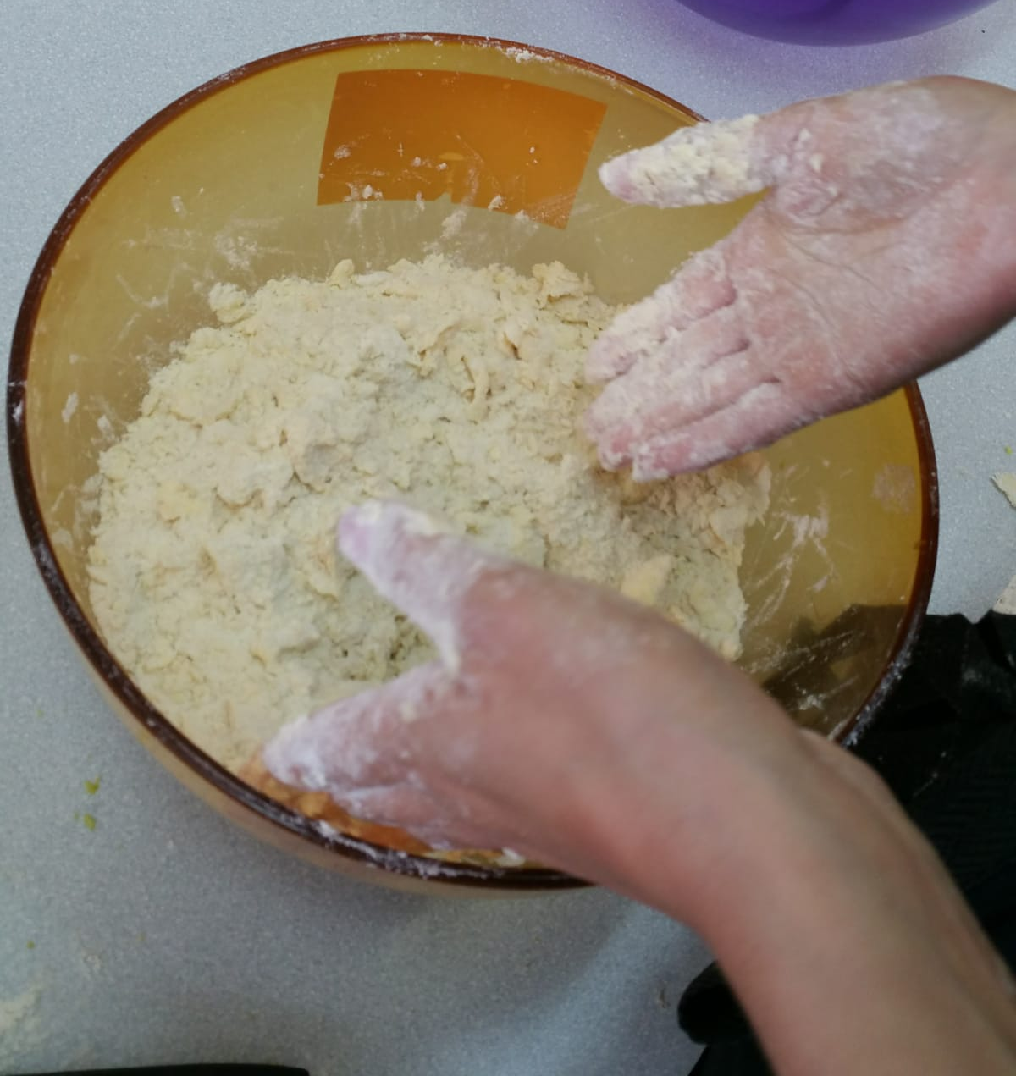
Qassatat Pastry Ingredients:
1 kg plain flour.
Pinch of salt
1 whole egg and 1 egg white
300ml olive oil.
Water to combine dough.
Method:
Shift flour into large bowl and add a pinch of salt.
In a small bow, with a fork, lightly beat the egg white and add the olive oil.
Make a hole in the centre of the flour and add to the large bowl.
Mix the ingredients together.
Add enough cold water to combine and form a ball of pastry.
Wrap in cling film and place in the fridge for at least 20 mins.

Slide 38
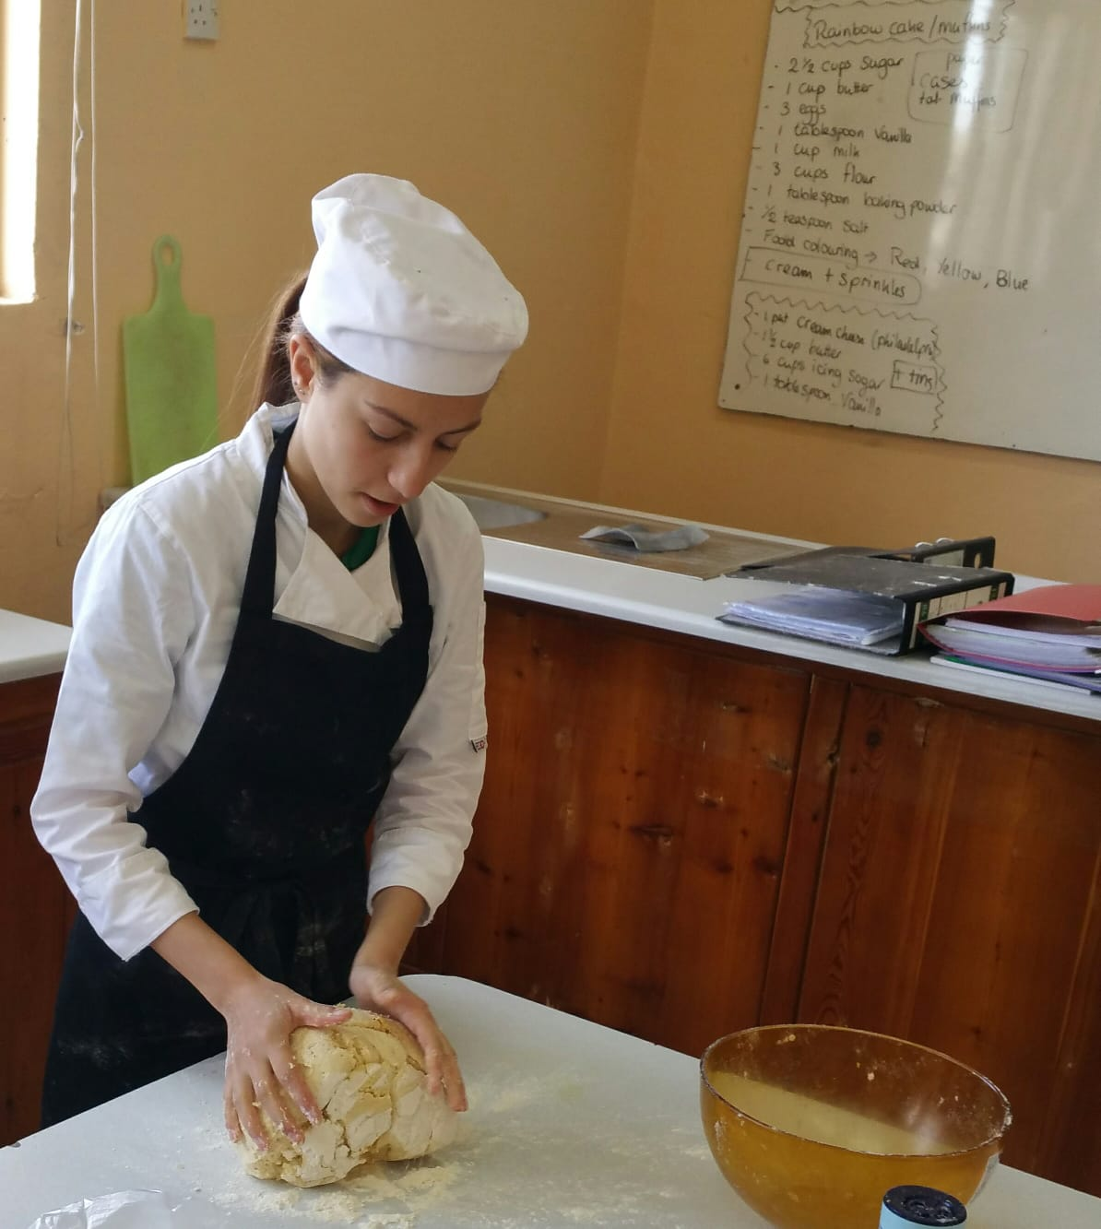
Students studying Hospitality at our school preparing the dough for the Qassatati.

Slide 39
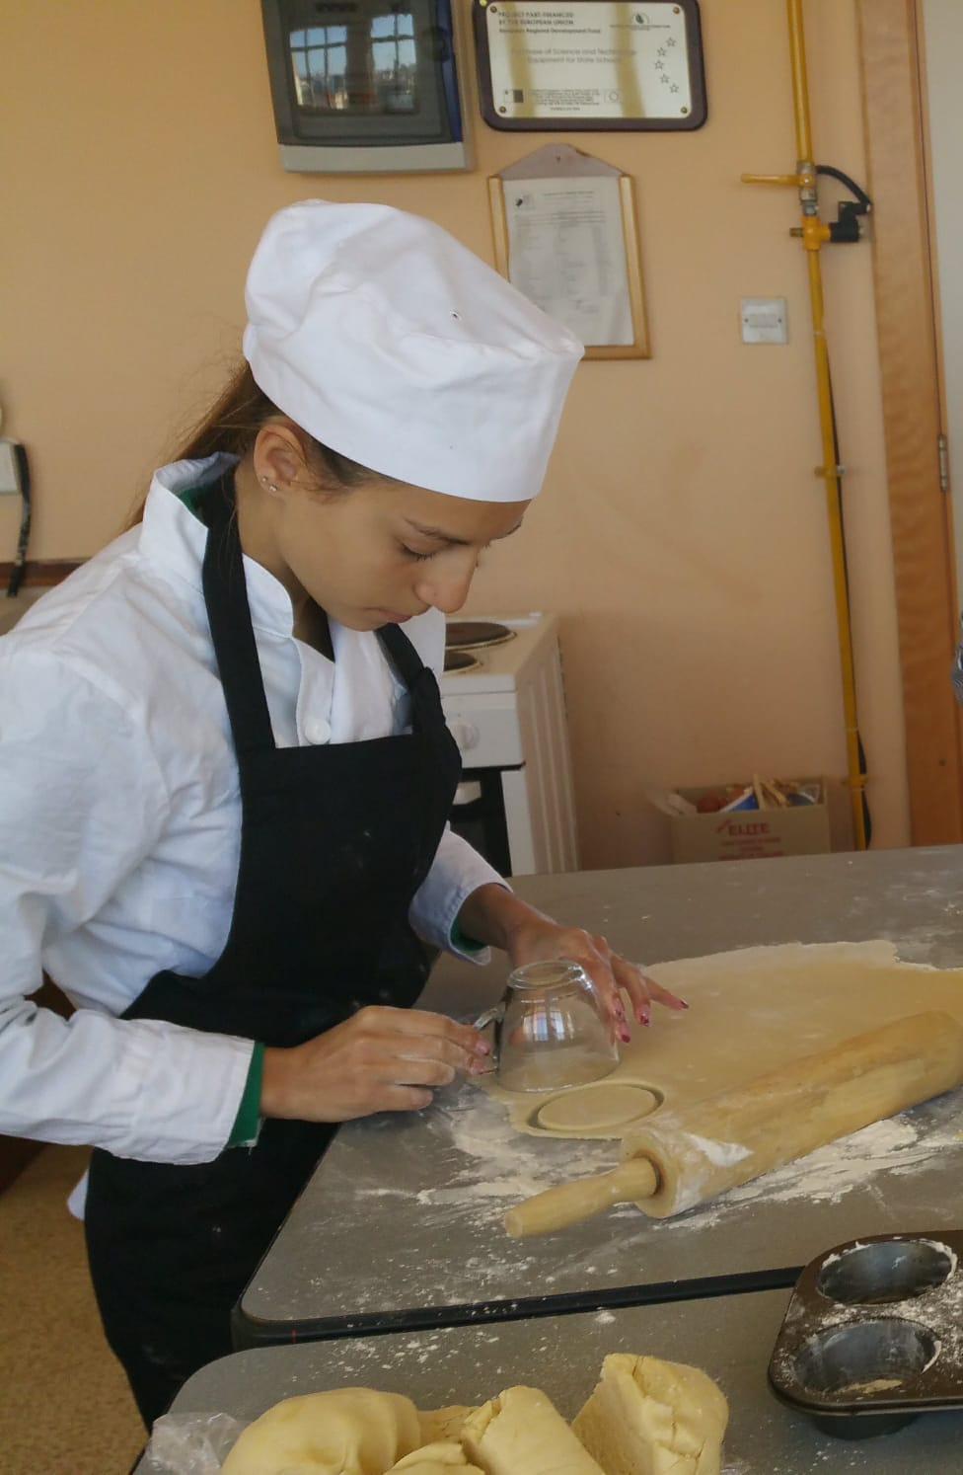
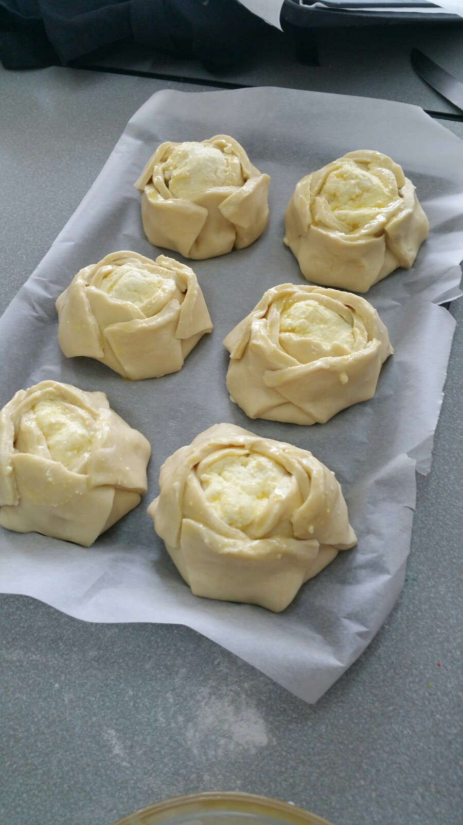
Hospitality students cutting the dough in circles ready to fill them with Qassatat cheeselets filling.

Slide 40
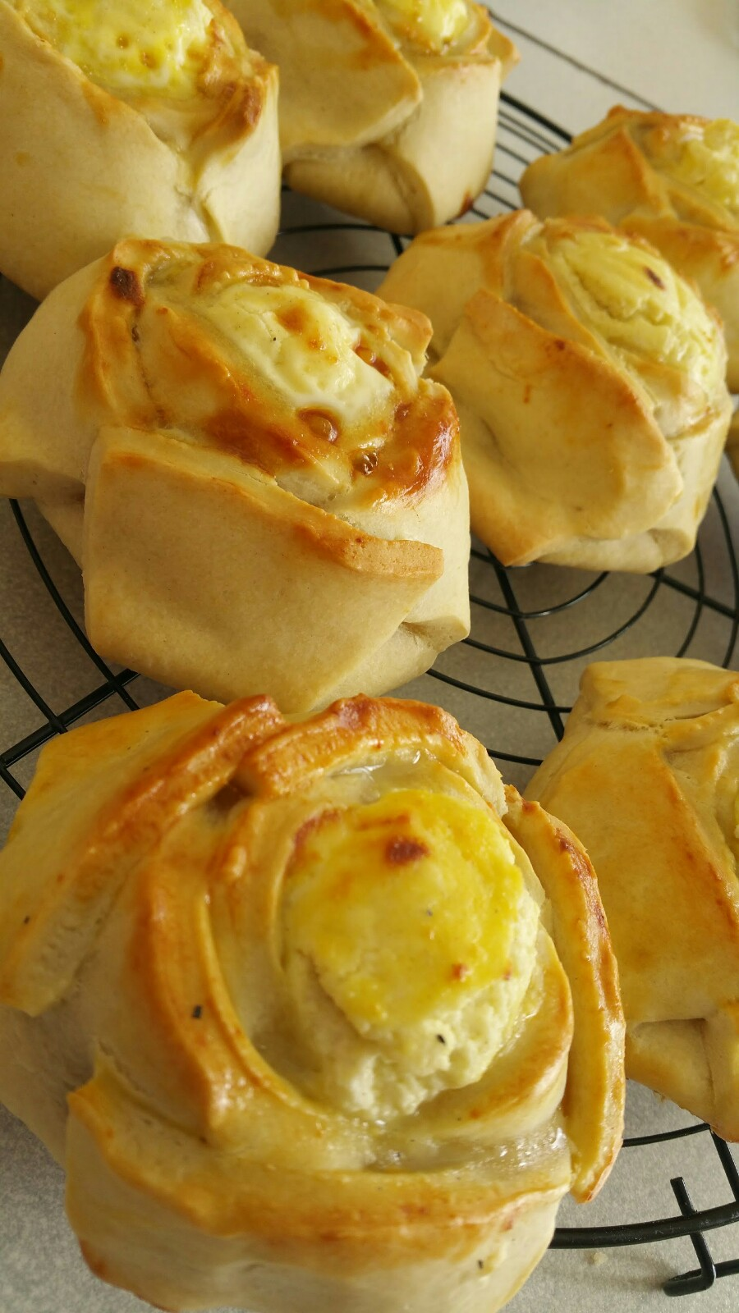
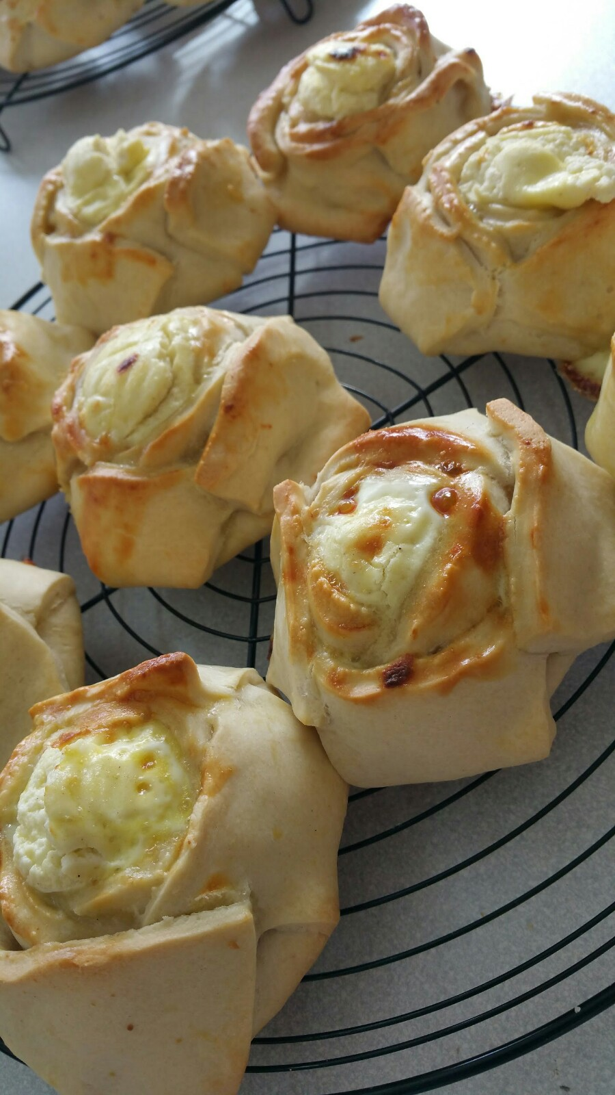
The finished product:
Qassatat with organic cheeselets filling.

