Slide 1
Erasmus+
Implementation of Action 2

Slide 2
Aims of action 2
The aims for this action were:
Transversal and Basic skills
Using problem-based and inquiry-based learning
Cross curricular approach
The use of LABs
Cooperative learning methods
The use of ICT

Slide 3
Implementation of action 2
Took place on the 30th and 31st of October 2017
At school.
A 10-hour lesson which was spread over two days.
Topic was MUSIC

Slide 4
Aims of lesson
Students had to make use of the knowledge learnt about different music styles and lyrics writing, to write a blog related to music.
Students also had to read about a particular singer and come up with a set of interview questions which could be asked to this same singer.
The main methodologies used to achieve these aims include: Co-operative learning, the Learning Scenarios and Flipped Classroom.

Slide 5
1. Transversal and basic skills
Transversal skills and competences are relevant to a broad range of occupations and sectors. They are often referred to as Core skills, Basic skills or Soft skills.
Students achieved this through the implementation of Action 2 because they had to recognise different genres of music, listen to and evaluate lyrics from different songs, identify poetic language and make use of academic English. This was enhanced through the knowledge and use of ICT.

Slide 6
2. Using problem-based and inquiry-based learning
We had a local music blog writer, Mr. Michael Bugeja of: www.mikebugeja.com ; as a guest for the first phase of the lesson.
Students were able to ask questions about blog-writing to our guest, which then helped them improve their final product.
This enhanced inquiry-based learning as students got to learn by asking questions themselves.

Slide 8
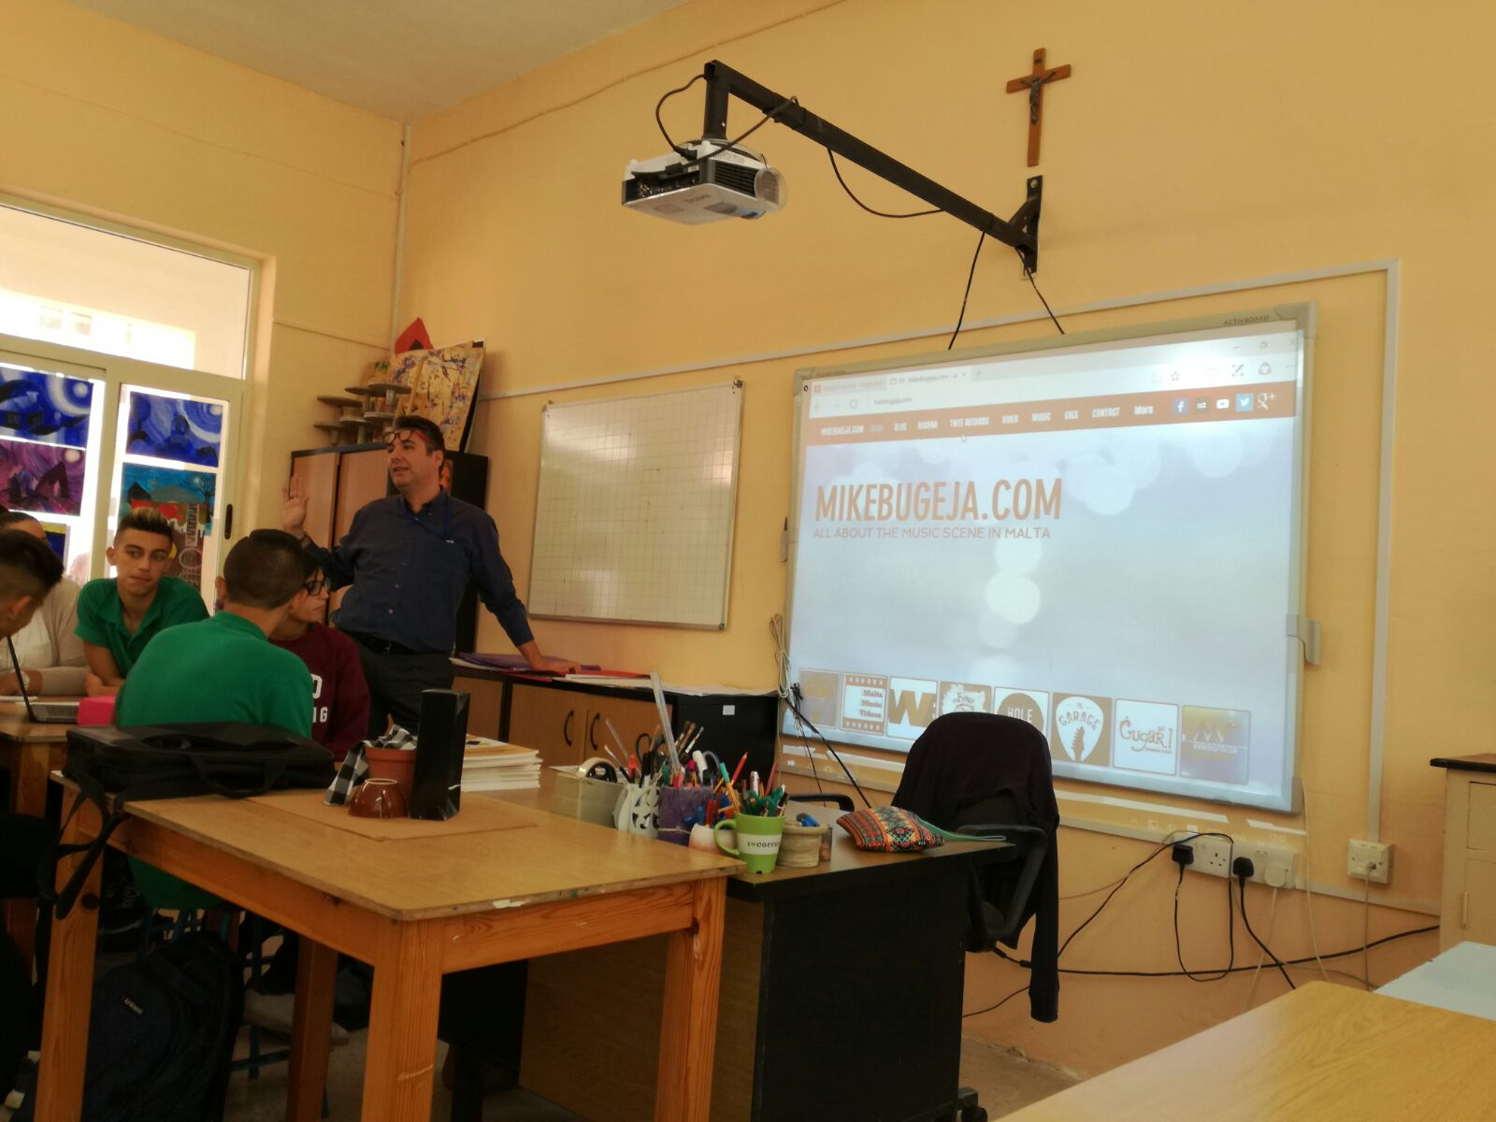

Slide 9
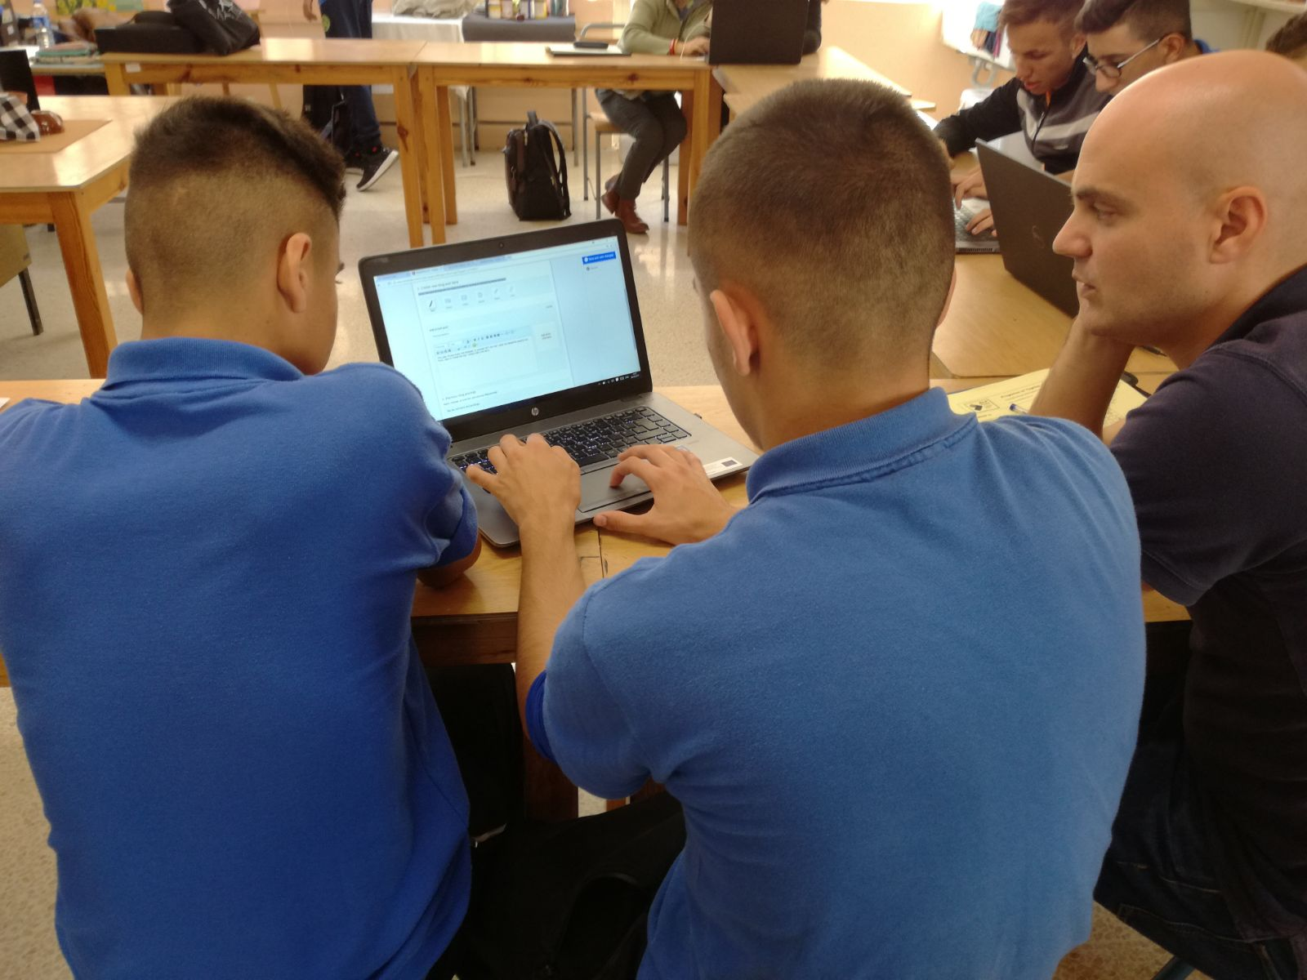

Slide 10
3. Cross curricular approach
Having a cross-curricular approach to teaching is characterised by sensitivity towards knowledge, skills and understandings from various subject areas.
In the implementation of this lesson, students had literature, music and academics intertwined in 1 lesson. Therefore, they had to combine their passive knowledge about the subject with research, in order to come up with the final product.

Slide 11
4. The use of Labs
The Computer lab at our school was used for the implementation of Action 2.
Each student had access to a computer, therefore the process of searching for information was far more successful in this manner.

Slide 12
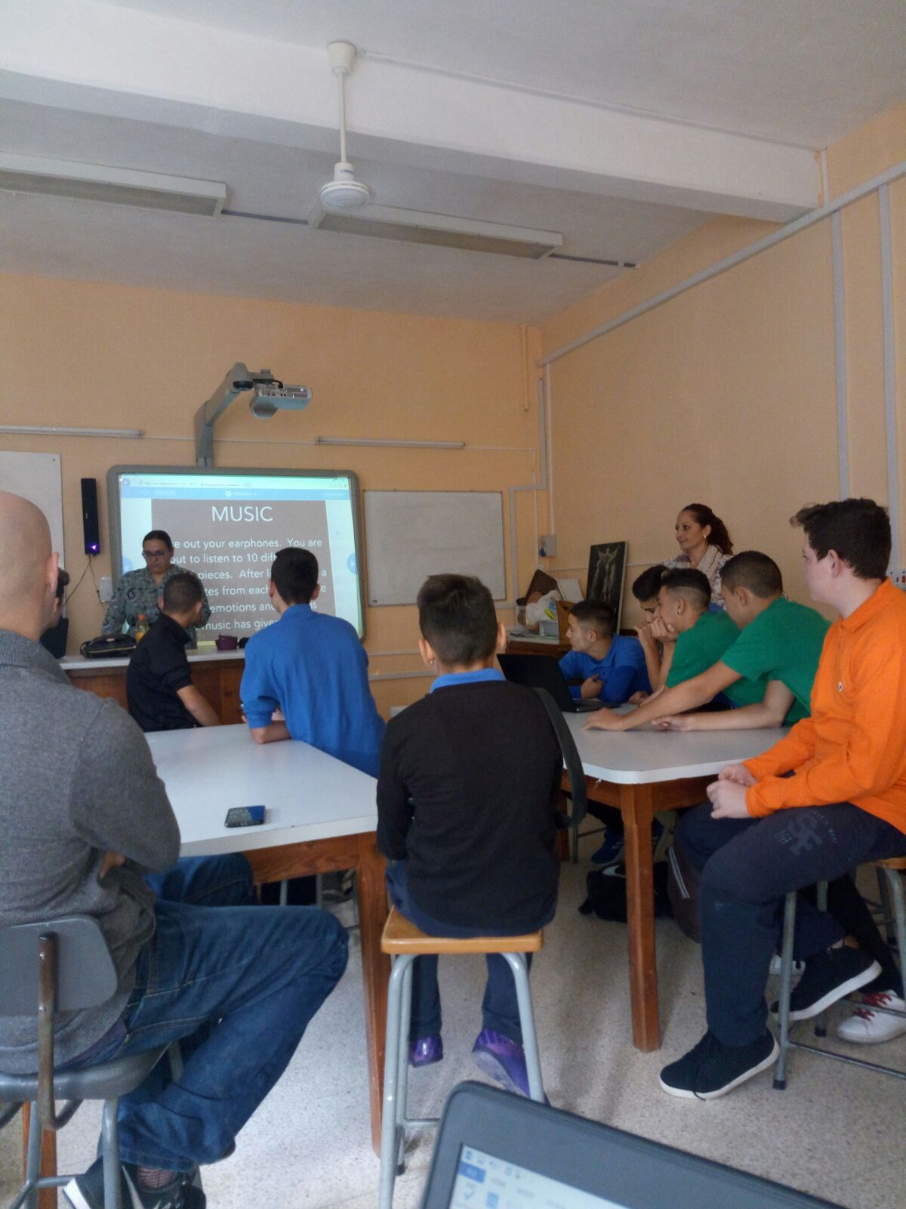
Implementation Activities for Action 2

Slide 13
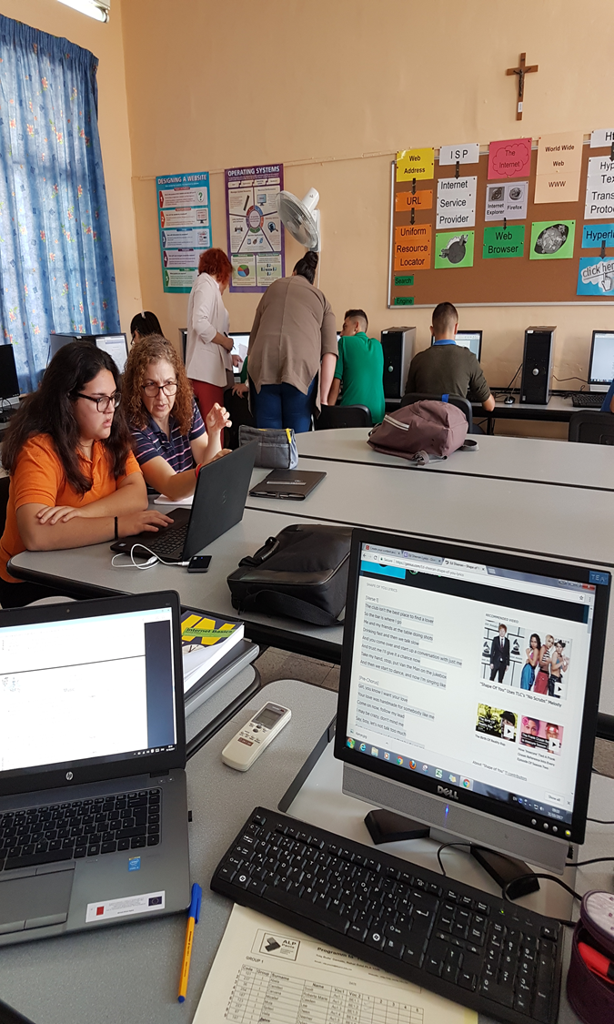
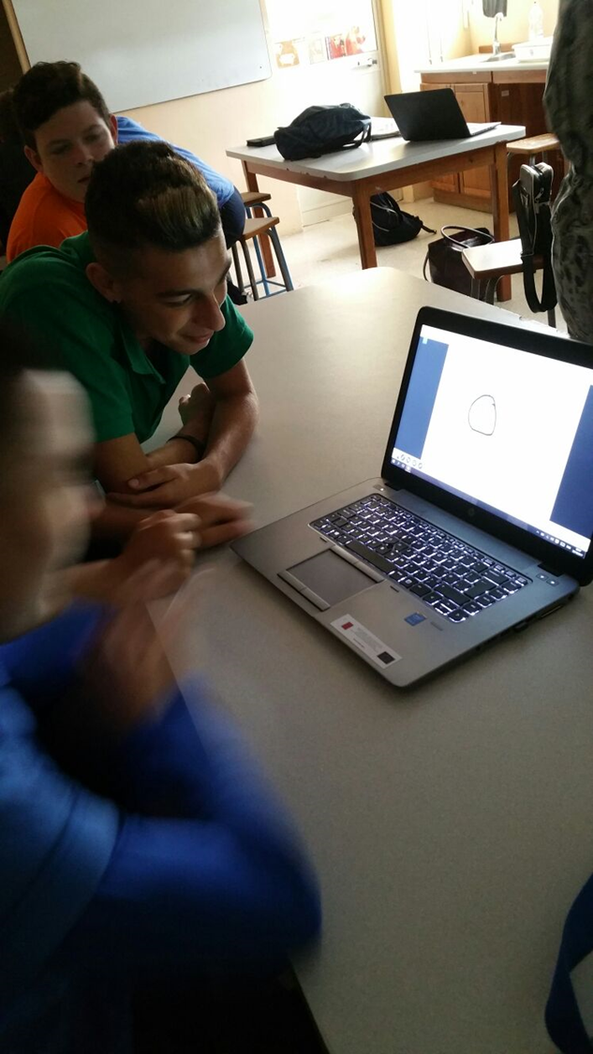

Slide 14
5. Cooperative learning methods
Students were divided into groups for most of the 10-hour lesson. Through cooperative learning, students were able to:
share ideas and opinions,
speak about their likes and dislikes,
and search and share information.

Slide 15
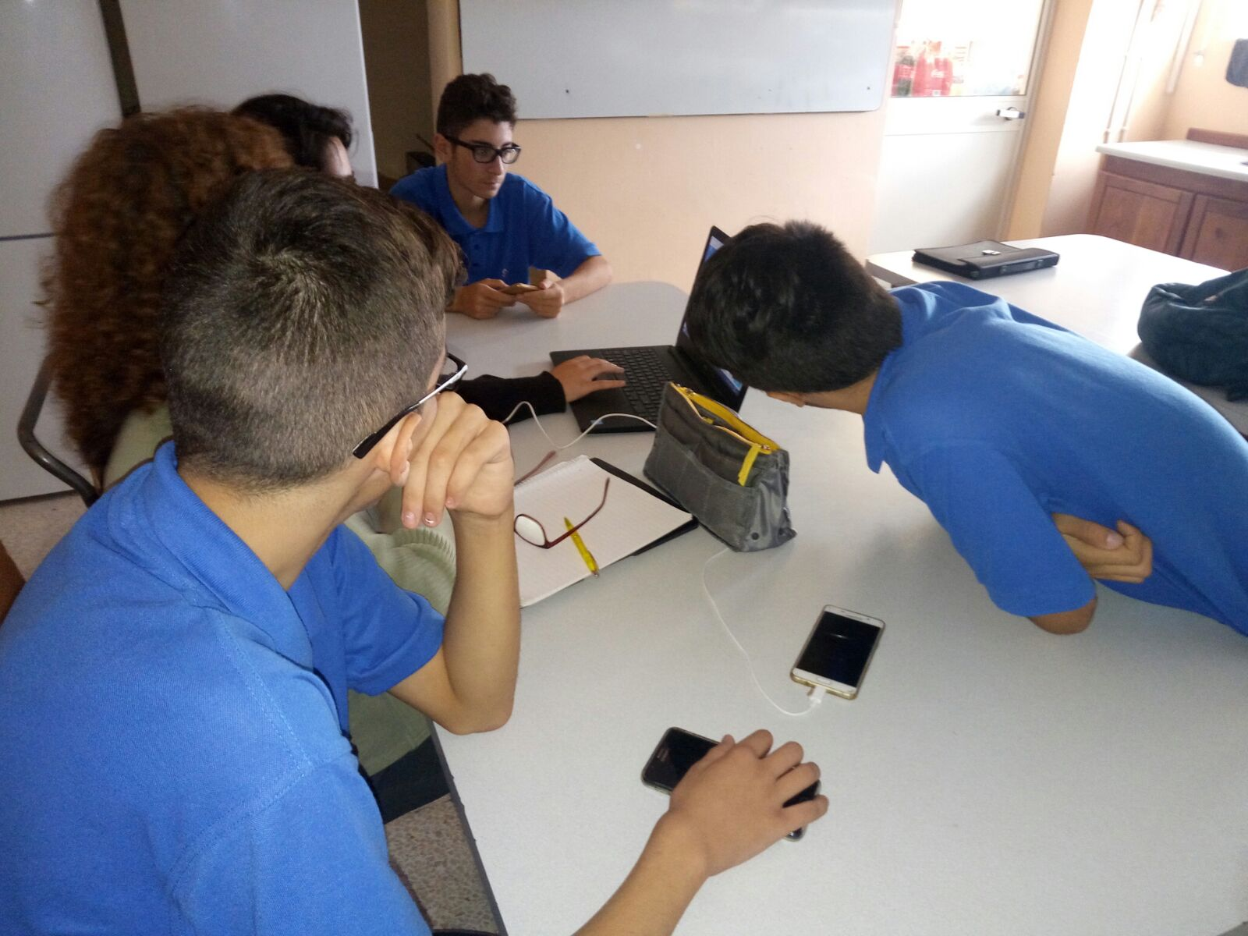

Slide 16
6. The use of ict
For the first and introductory task of this topic, students had to listen to 10 songs
After each one write the thoughts, emotions and ideas that were delivered through the songs.
For this activity we used nearpod.com.
Visit the link:
https://share.nearpod.com/vsph/TbtkOgdb7H

Slide 17
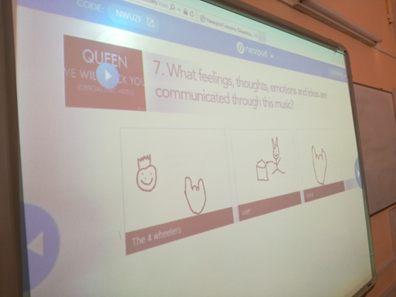

Slide 18
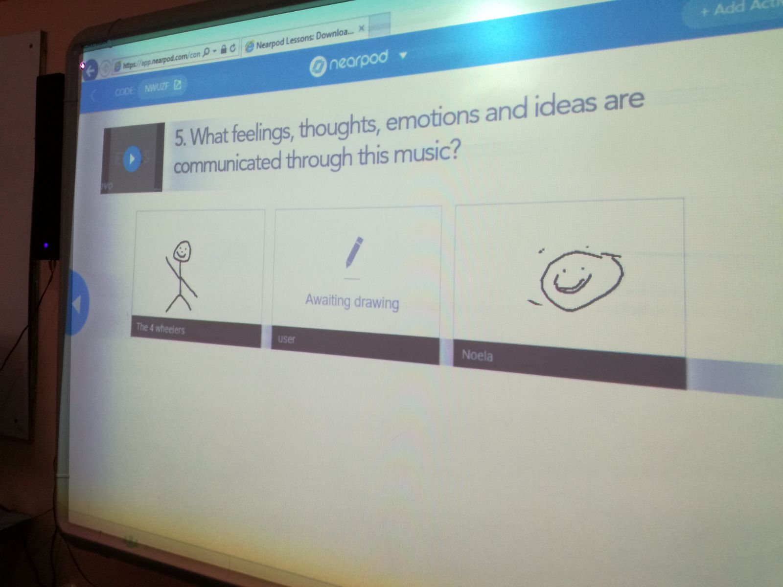

Slide 19
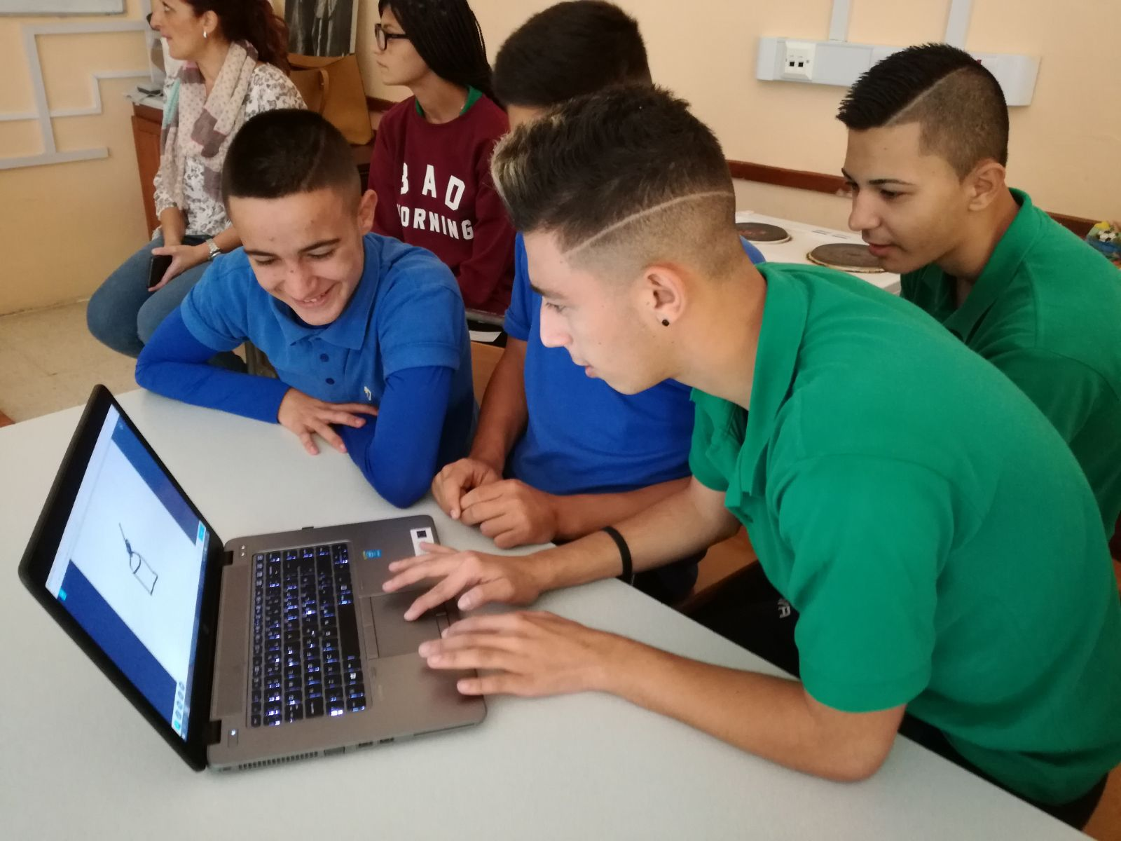

Slide 20
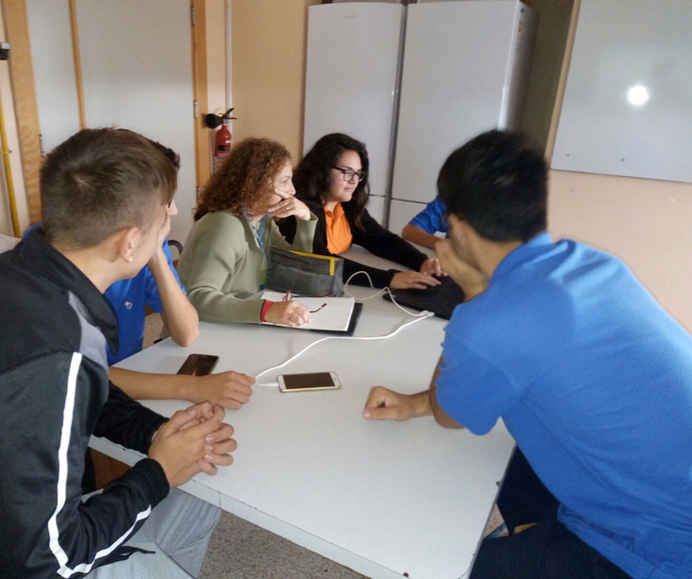

Slide 21
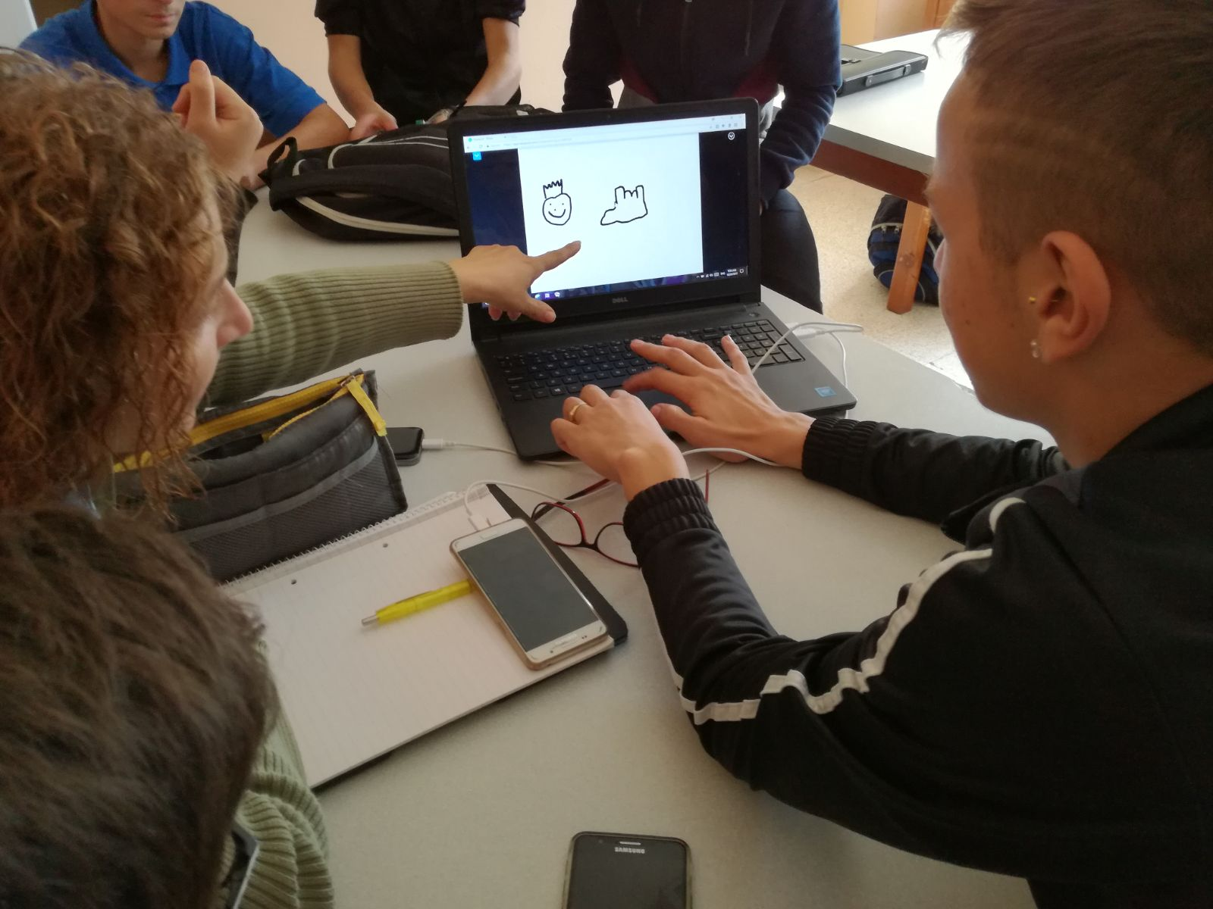

Slide 22
6. The use of ICt
Moreover, instead of settling for a simple blog, in order to make further use of ICT, we decided that the interview would be filmed and uploaded as a video blog a.k.a Vlog.

Slide 23
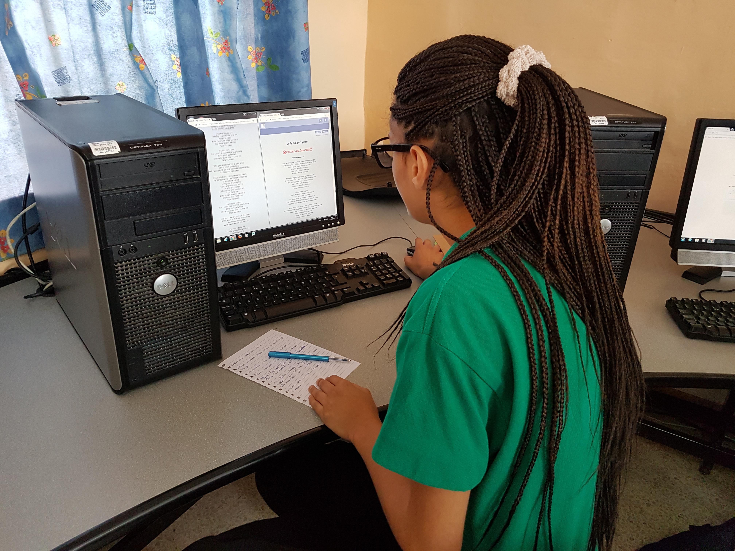
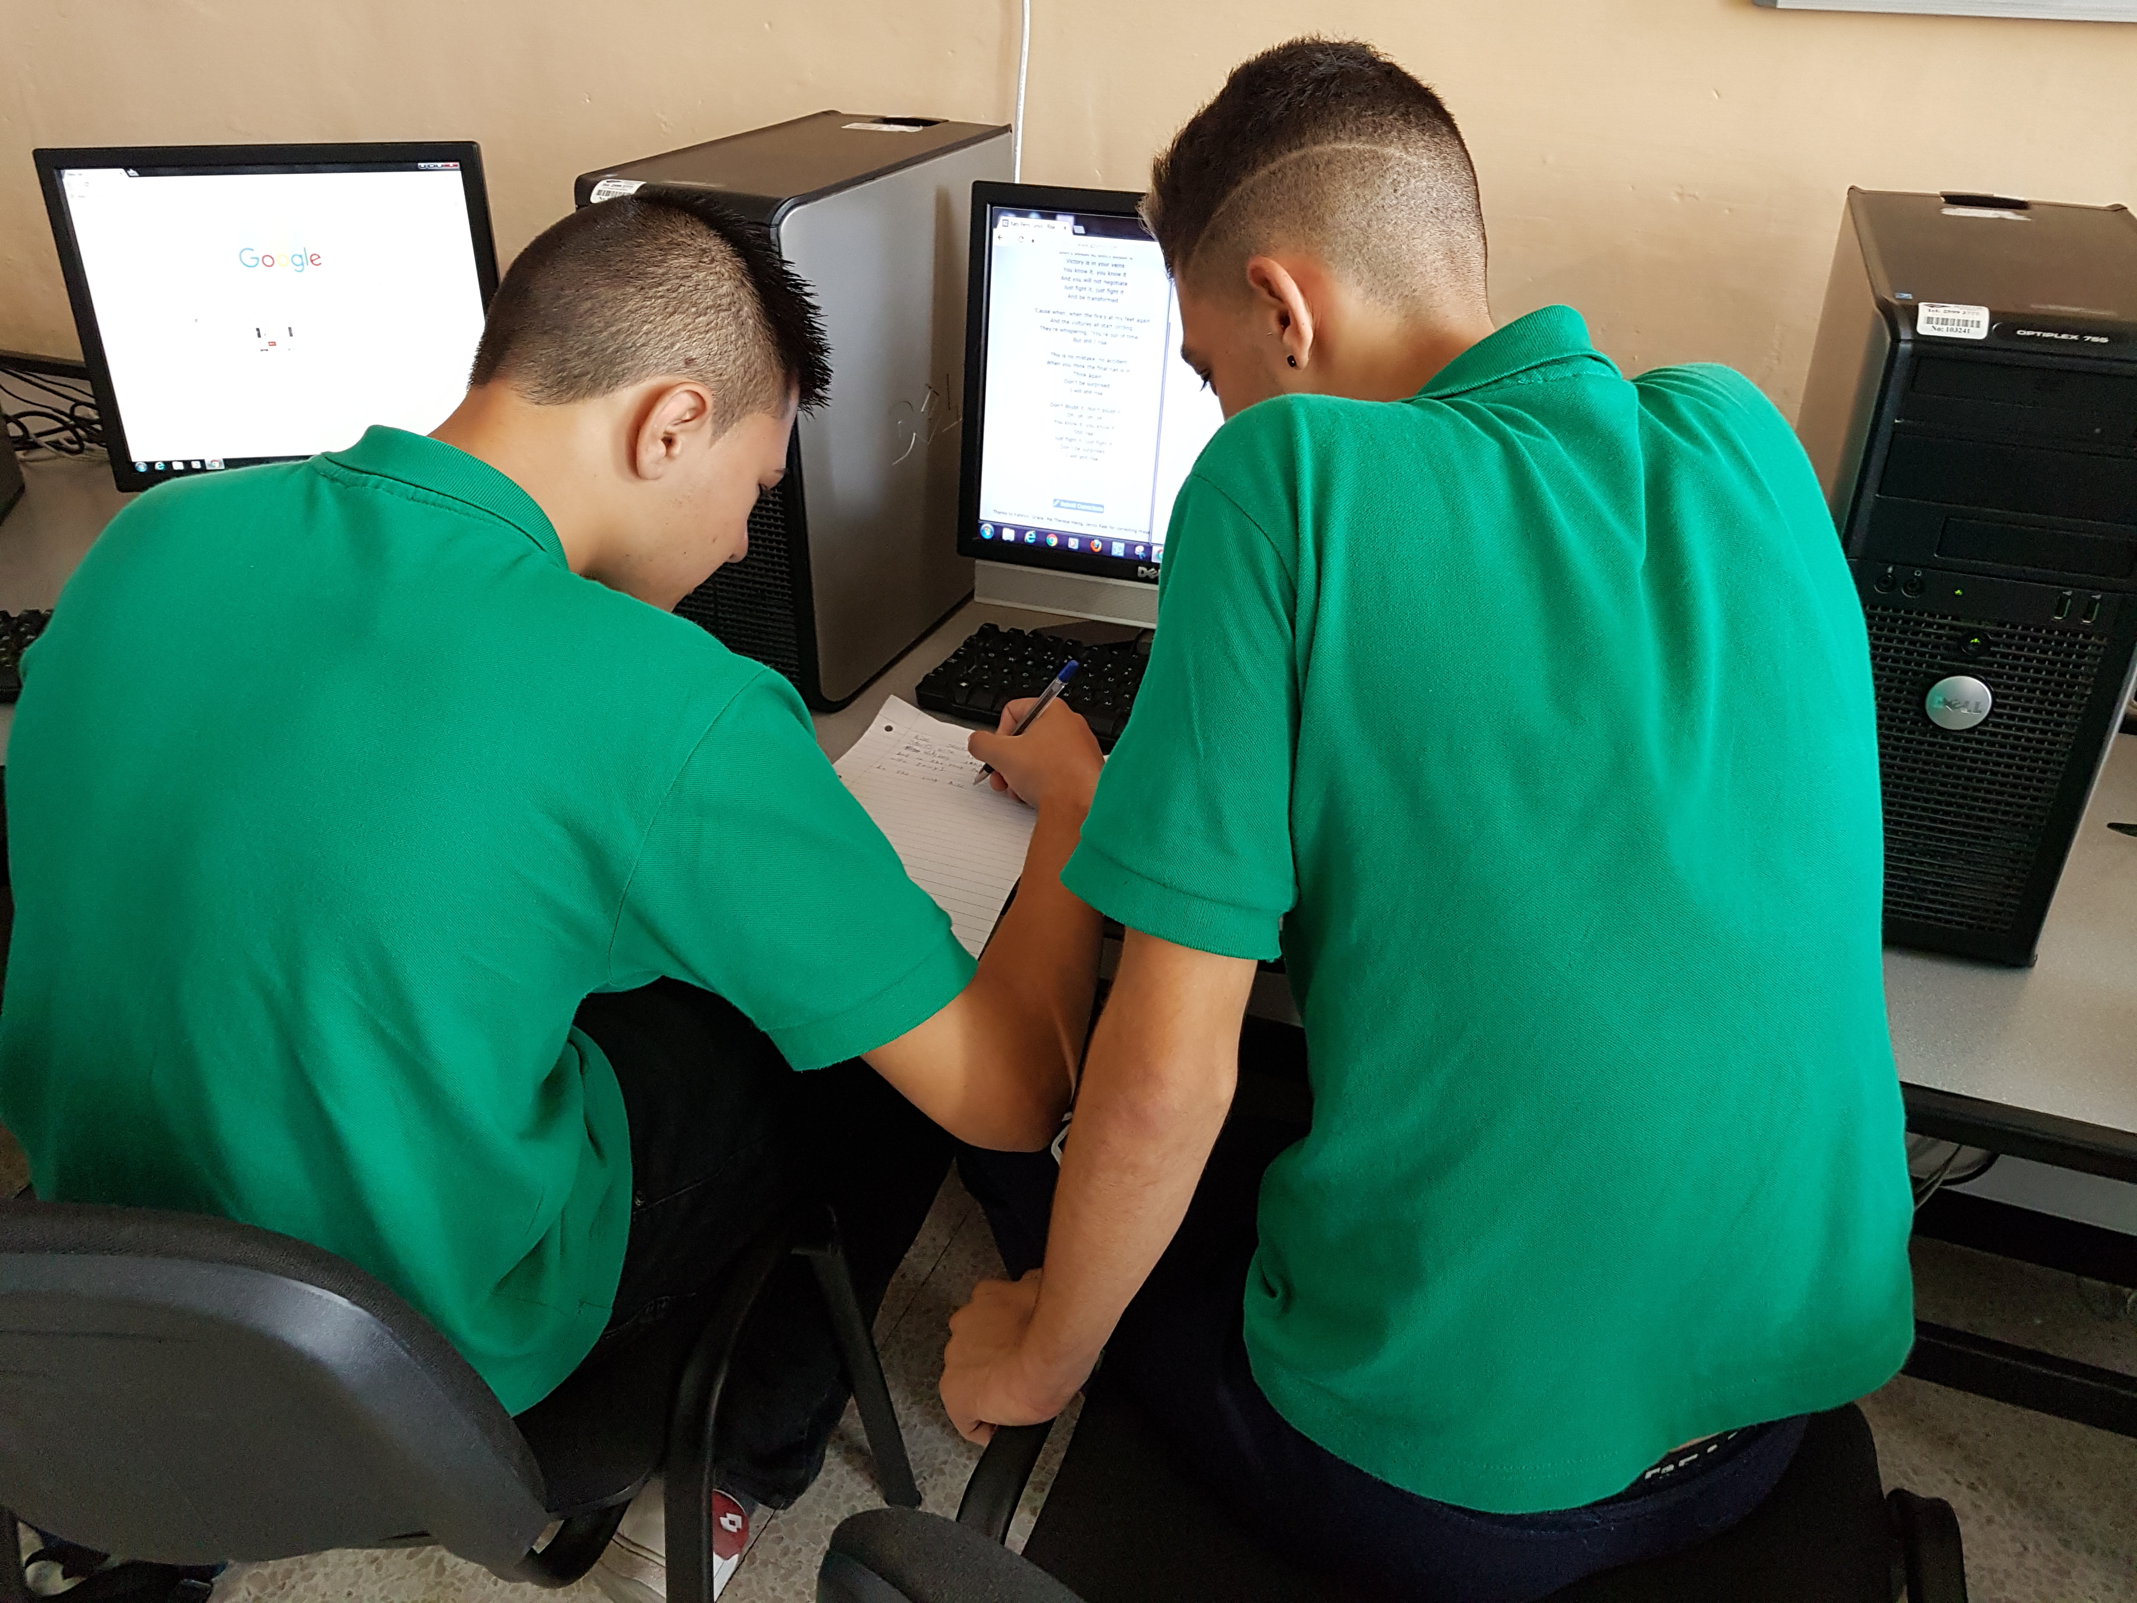
Students creating their
Vlogs in the ICT Lab

