Slide 1
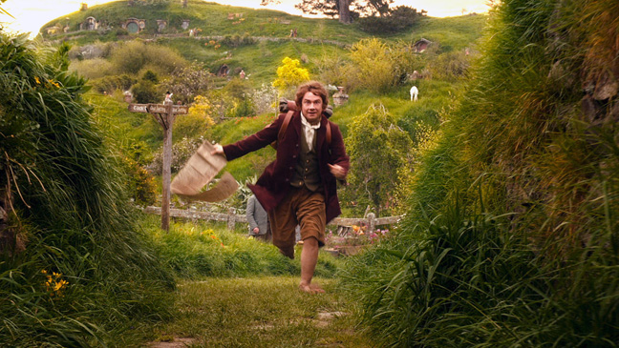
The maths
Unexpected journey

Slide 2
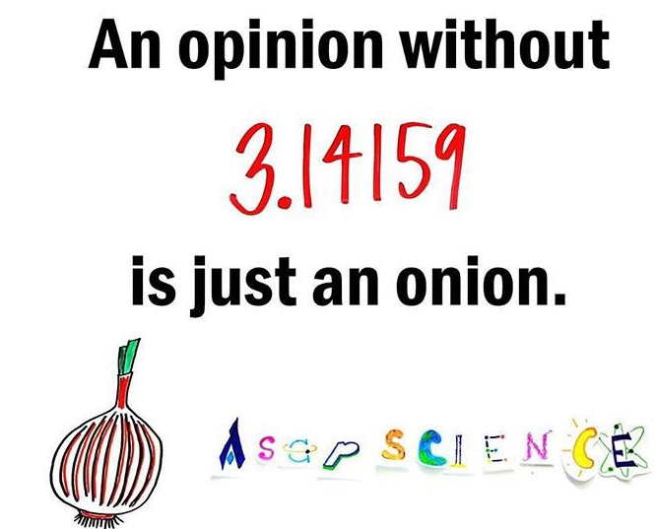

Slide 3
Statistics
We’ve studied statistics in 8 hours
During our previous studies we have already learnt the concepts of modus, median, simple average, absolute and relative frequency etc.
With the help of these knowledges we could resolve the exercises.

Slide 4
Working with
Kahoot is a professional application.
During classes we almost everytime do maths with pen and paper and it can be boring.
Kahoot can be solution for that ”problem”
We made seven groups and we were fighting against each other.

Slide 5
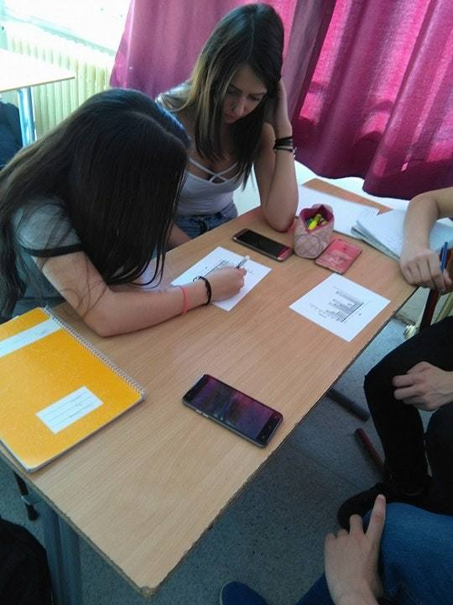
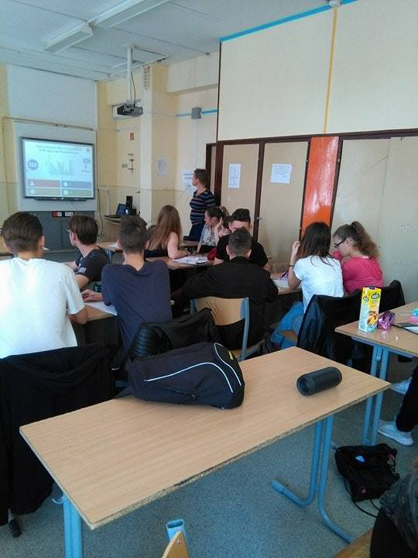
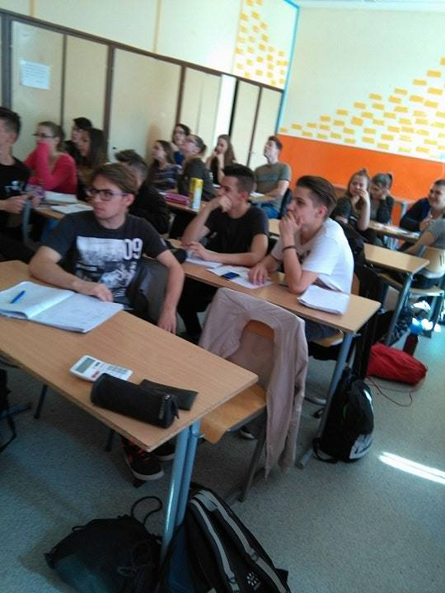
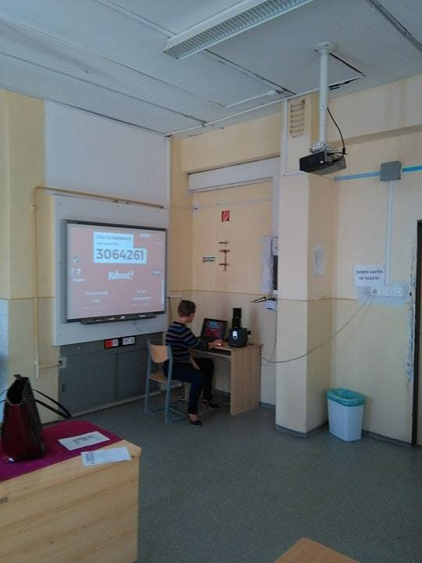

Slide 6
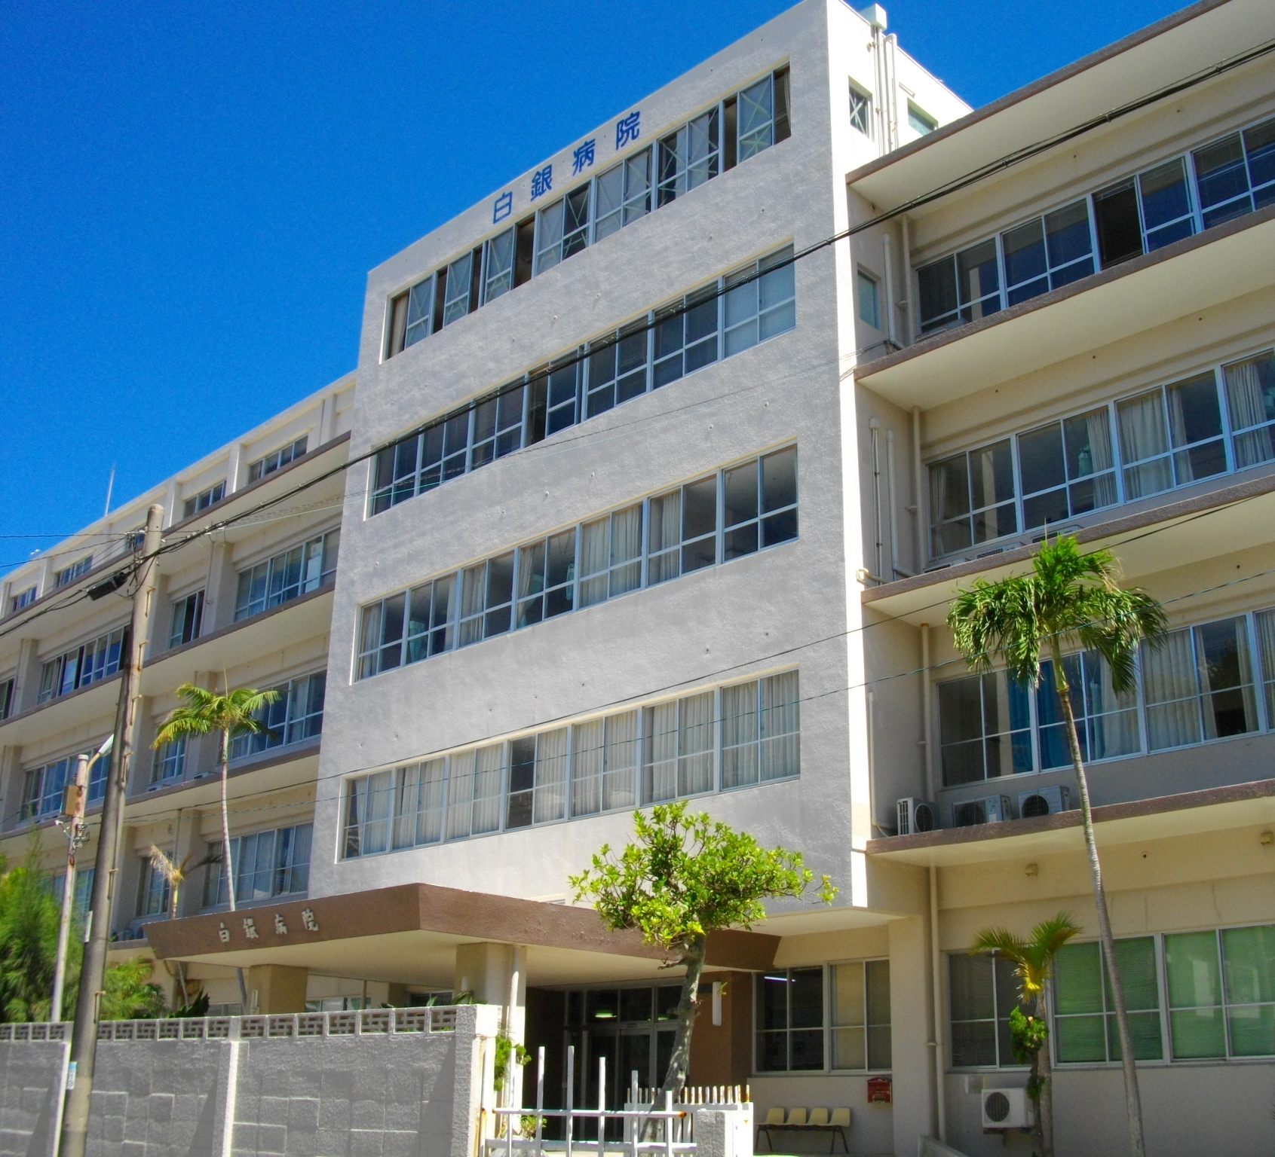
The final exercise
The goal was to find 7 cities in bee-line.
We had to try to put hospitals to each city.
First of all we have made calculations about the distances between the cities.
After that we researched the population of the 7 cities.

Slide 7
These were the basic calculations:
We have add up the distances between the cities.
After that we were multiplying these distances with the populations of the cities.
After that we could divide the final km numbers with the total population
We built the hospital where there was the lowest km number.

Slide 8
My experiences
In total it was a really good learnig period, because it was:
Fun, helpful, challenging, entertaining and something new
Before this project I didn’t really like maths but these 8 lessons changed my attitude

