Slide 1
Literature lessons
On the first lesson we made teams, our according to agreement we will work together after shool and we will make prezentation about Women's Equality.Womens only cooked,washed,cleaned and breed their childrens since hundred years ago.They must'nt go to the street without a boy/man, they must'nt go to the celebrations, only the man's.Nowadays the womens has rights in Europe and they may learning, driving etc.
Nowadays some countries like India the indian womens must'nt
drive
go to the street lonely
They are only a thing so the mans/families are buy them to helot,wife or whatever what the mans want.Womens start Feminist Campaign aganist and than somes countries they achieve rights.

Slide 2
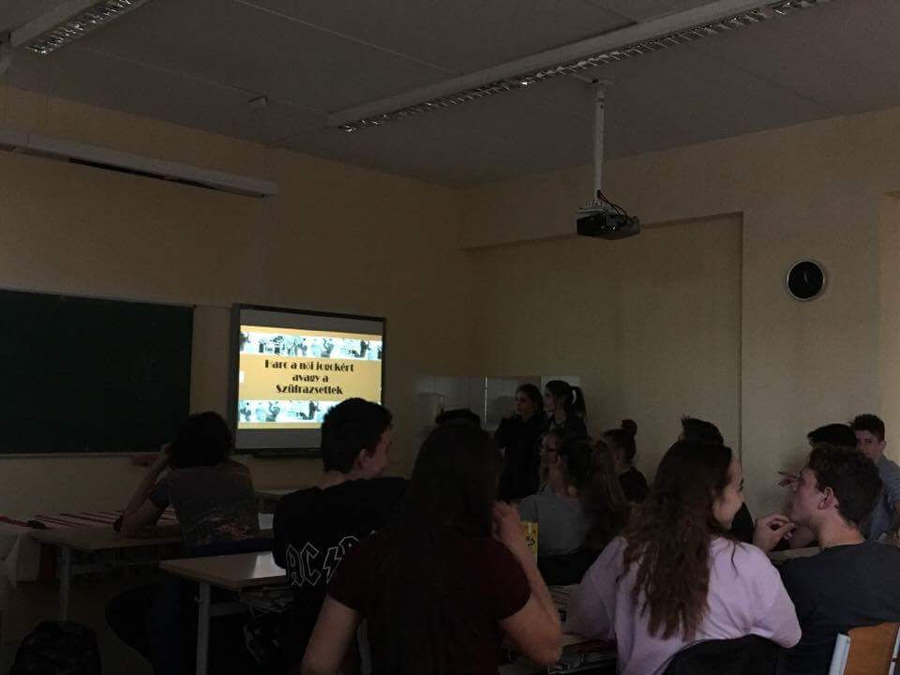

Slide 3
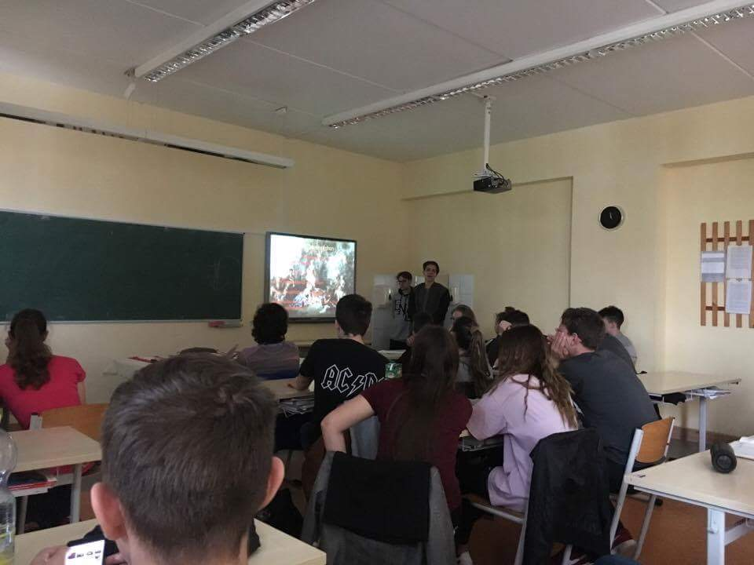
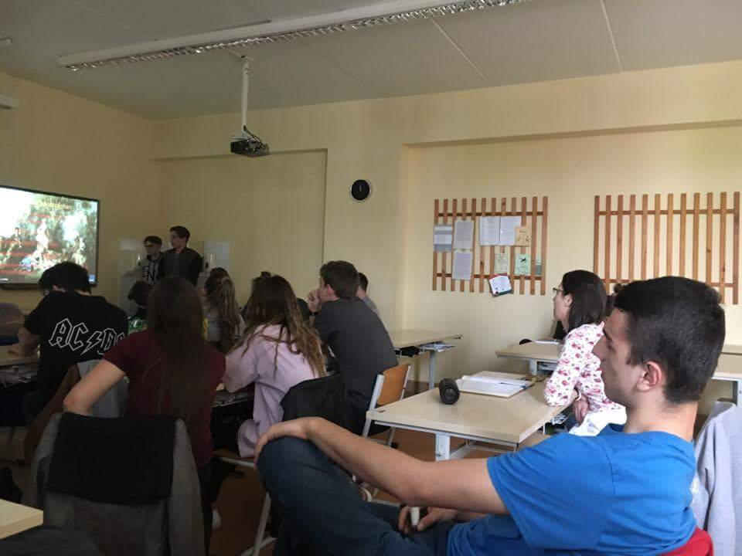

Slide 4
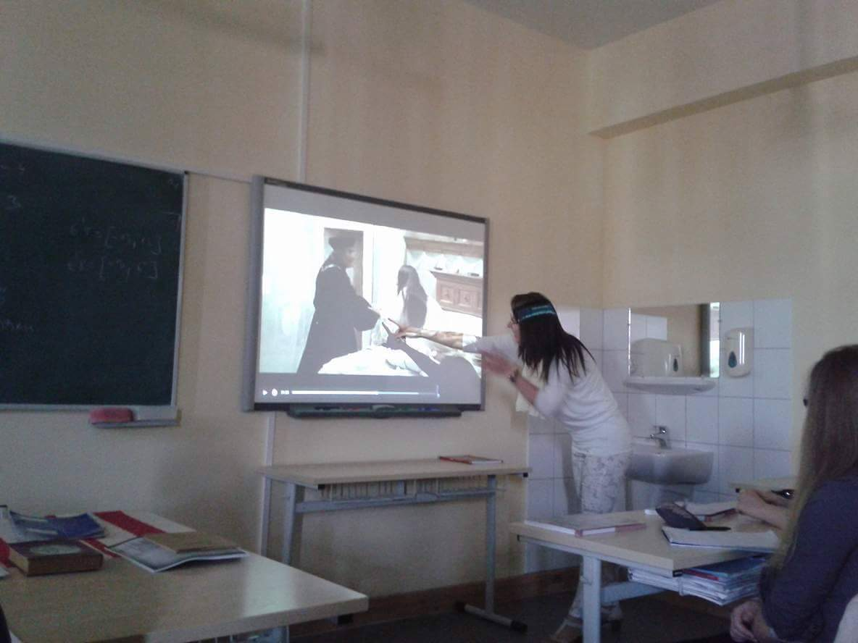
We saw the movie and we analised the Romeo and Juliet, Shakespeare 16-17th centurys works.Juliet promise to ther mother that she will love the man what their perents want.She could'nt say who will love, but she met Romeo on a party and they fall in love at first sight so she don't want to married with another person.When their father heard that he beat Juliet and he say she will not their children if she isn't keep her promise.

Slide 5
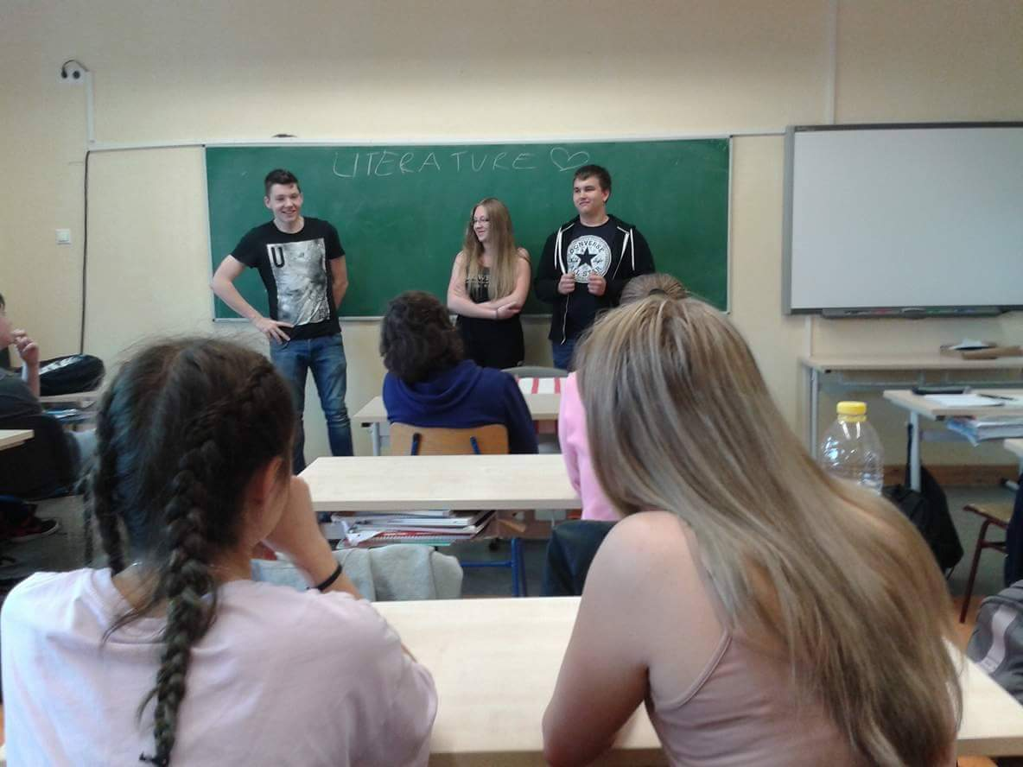
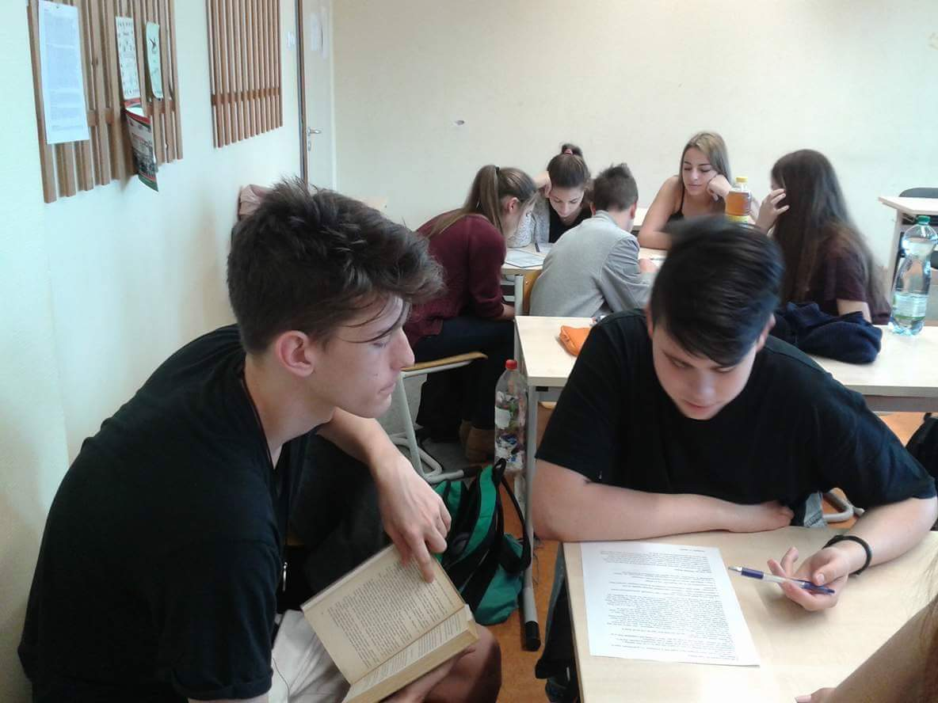
We analised Pride and Prejudice, Jane Austin 1700th work and we made a reading test from this.In this century's the same situation about womens because in this years too the parents choose the husband for their daughter.

Slide 6
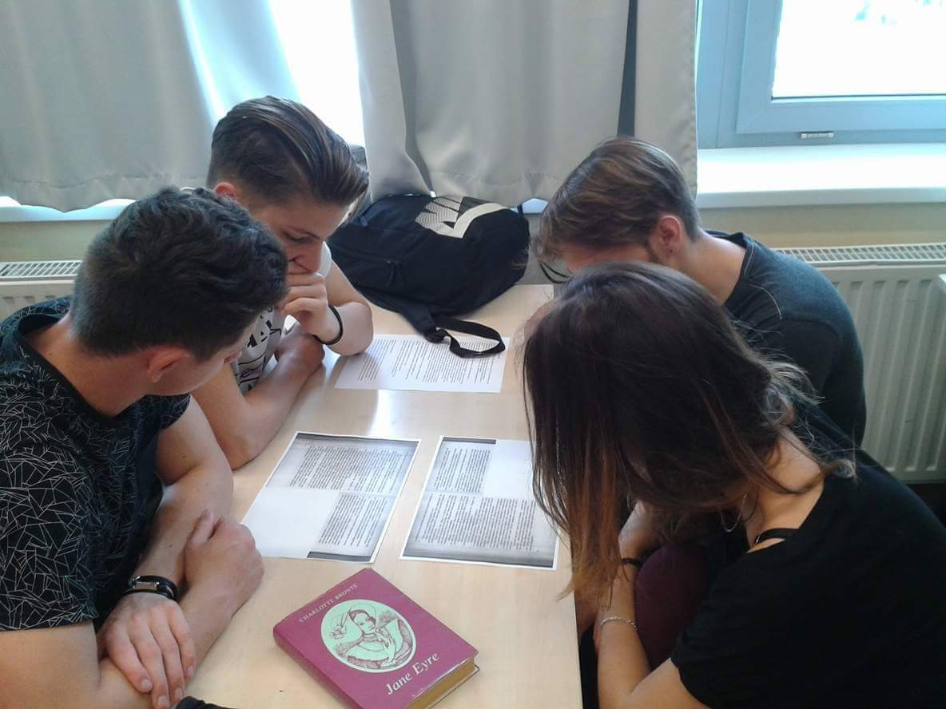
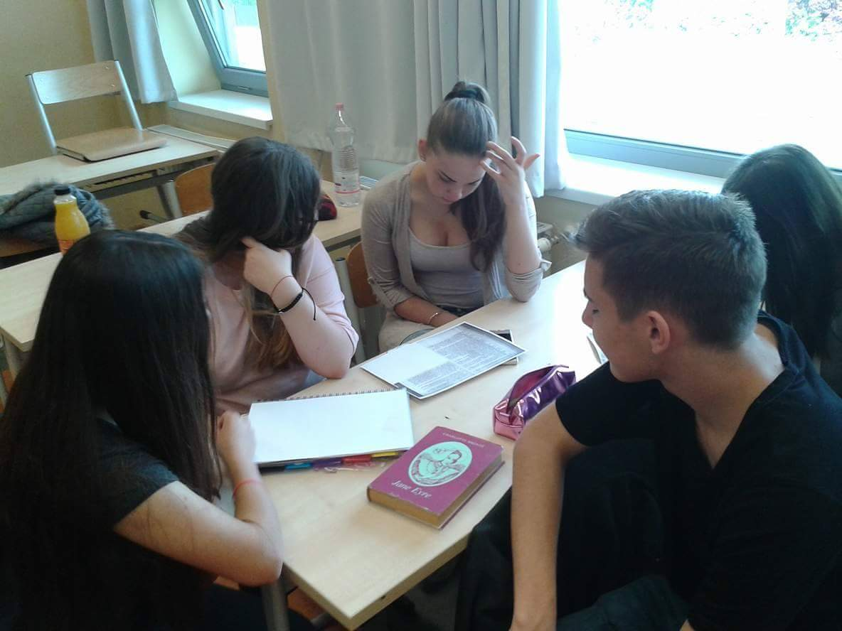
We analised Jane Eyre, Brontë 1947th work.The maid Jane fall in love into the lord of the house.She think the lord doesn't love him because she is only a maid, but in the end the lord and Jane will lovers.We make a test about it.
Finally if mans had a lot of partner he was falled,but when womens had they are rubbish or when the mans get divorced it's naturall, but when womens make it then peoples look down them.I think this situation will be the same.

Slide 7
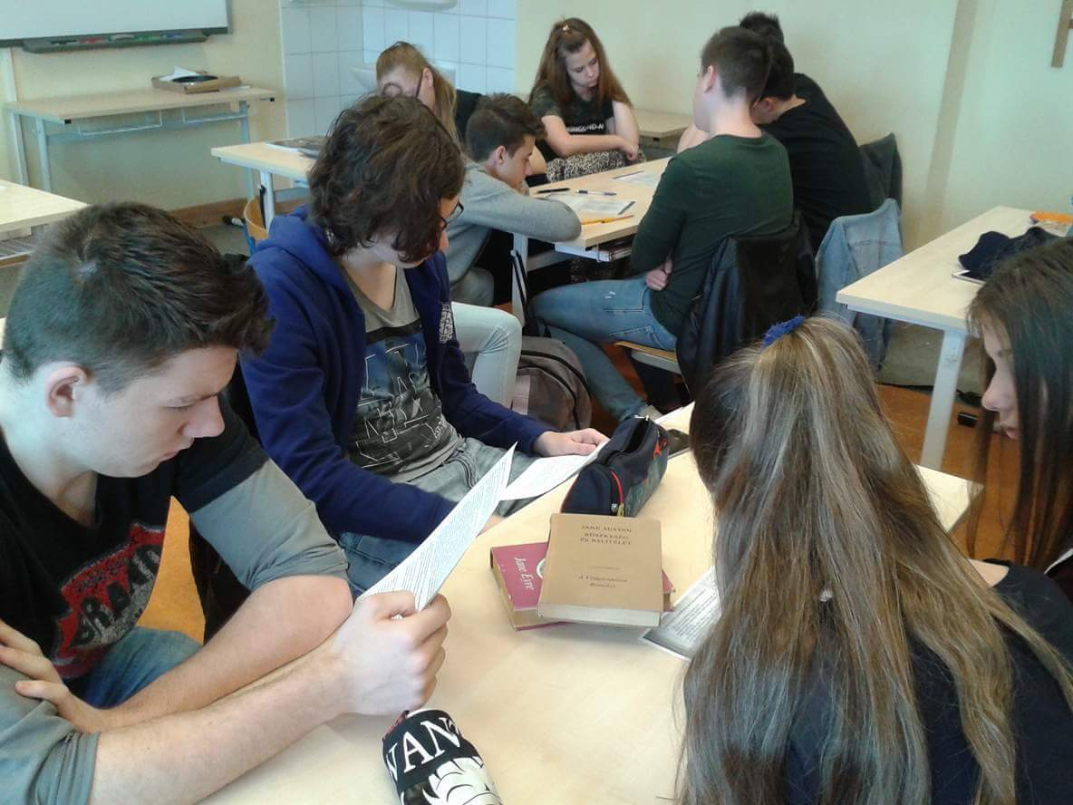
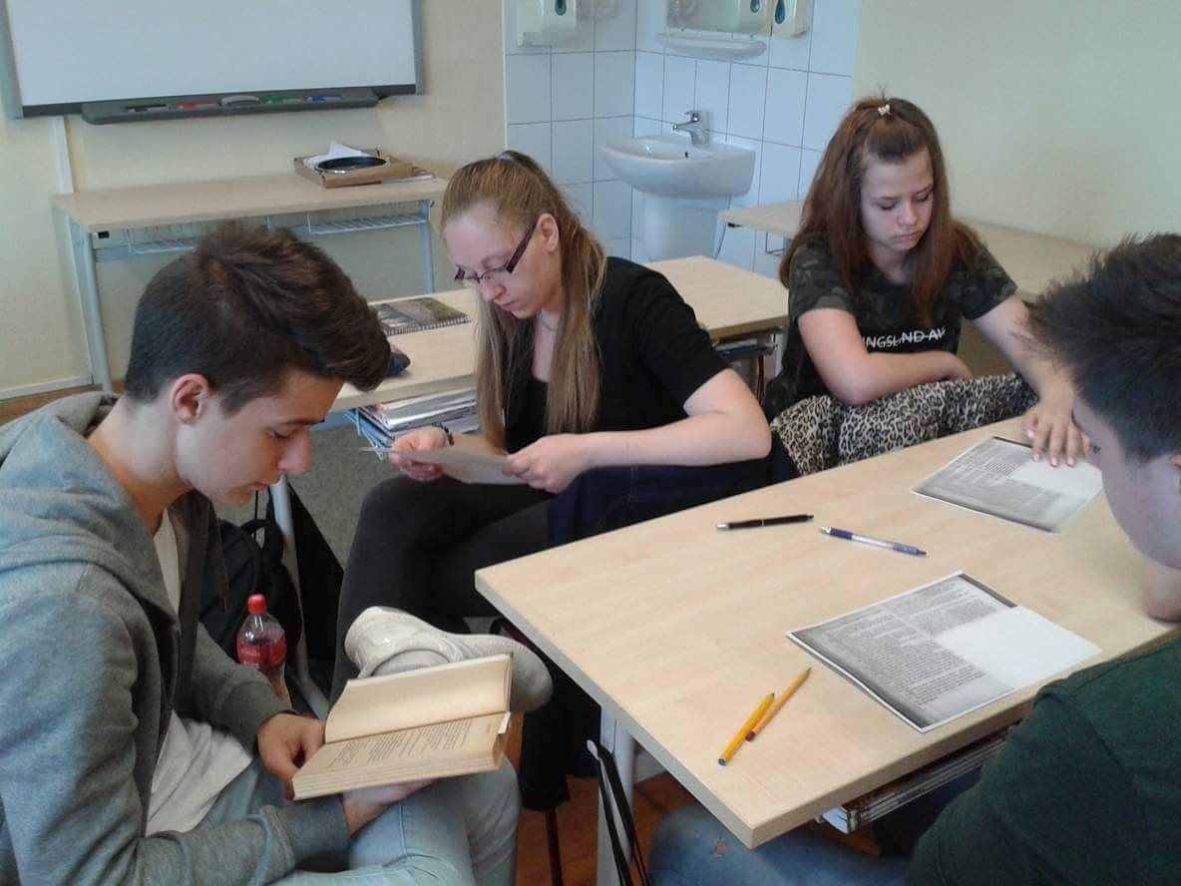
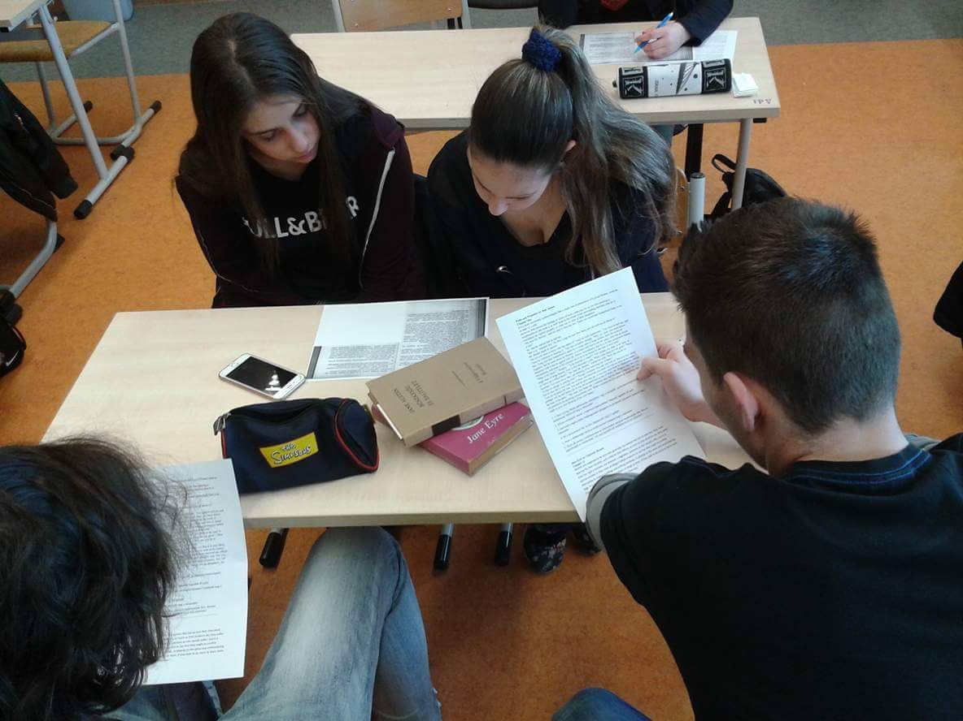

Slide 8
At the end we wrote a composition about it with our own ideas because it isn't the same.

