Slide 1
Traditional Portuguese Recipes
(Minho)

Slide 2
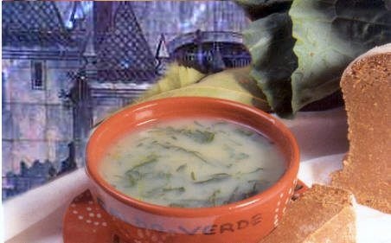
Caldo Verde à Minhota
CaldoVerde is a traditional Portuguese soup, made with mashed potatoes and Portuguese cabbage, very finely sliced and Portuguese chouriço (spiced pork sausage). Although typical of the Northern region of Portugal, this soup is much appreciated all over the country, and is one of the most famous popular recipes. It is served in clay bowls.

Slide 3
Ingredients
600 g of potatoes
4 slices of chouriço
200 g of sliced cabbage (Kale)
1 onion
2 garlic cloves
1.5 dl of olive oil
Salt a pinch
2 slices of corn bread

Slide 4
Preparation
Peel the potatoes, onion and garlic and bring to a boil in 1.5 liters of water seasoned with salt and half the amount of olive oil.
Meanwhile rinse the cabbage and sliced it.
When the potatoes are cooked, reduce it to a puree along with the onion and the garlic. Bring to the boil again and 10 minutes before serving, with the boiling broth, add the cabbage well drained.
Let it cook with the lid off until the cabbage is cooked but not over cooked.
Add the remaining olive oil.
Put a slice of chorizo in each bowl and pour in the Caldo Verde.
Serve it with the corn bread.

Slide 5
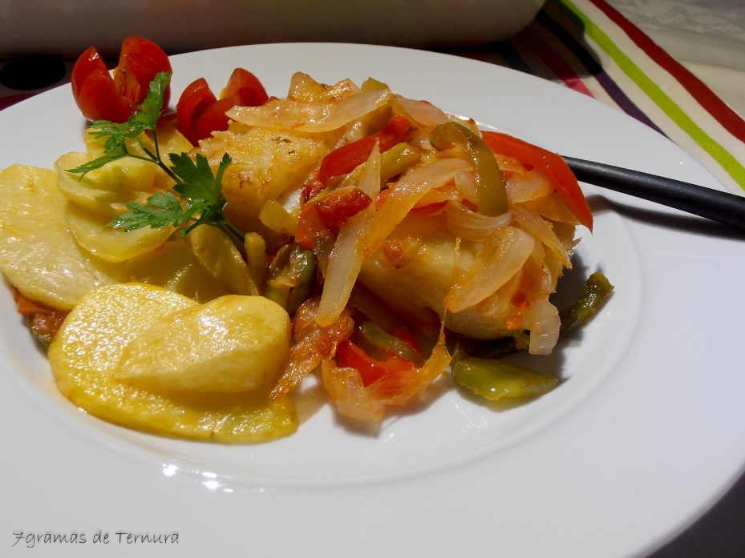
Bacalhau à Braga
This is a traditional recipe, very typical here of my city. A delicious recipe that deserves to be remembered and shared here. The peppers and onion sauce leave the cod with a wonderful taste, and this is a very easy recipe to make. Despite the variations that each can give, the base of Bacalhau à Braga, is a good cod, because it makes all the difference in the final result.

Slide 6
Ingredients
4 cubes or loins of cod
3 onions
4 cloves of garlic
1/2 green pepper
1/2 red pepper
2 bay leaves
1 tbs vinegar
1 ripe tomato
salt and olive oil q.s.
ground pepper
potatoes q.b.

Slide 7
Directions
Heat the cod in a pan with water, when the water boils, turn off the heat and leave it in the water for 5 minutes.
Remove and dry with kitchen paper. Heat a frying pan with plenty of olive oil, add the bay leaves and two whole cloves of garlic. When the olive oil is hot, add the cod and let it fry.
Once it's done, remove and place it in a serving dish and set aside (place it in the oven to keep it warm).
Meanwhile, cut the onions and the other 2 garlic cloves in slices and place in the frying pan where you fried the cod and remove the 2 whole garlic cloves and the bay leaves.
Add the peppers cut in strips and the tomato cut in pieces. Season with salt and pepper, add the vinegar and cook until the onion is cooked.
Fry the potatoes cut into thick slices and place them around the cod.
Top with the onion mix and serve with a salad.

Slide 8
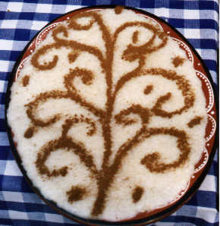
Arroz Doce
We can eat sweet rice in the four corners of the world, but there is no corner in Portugal where this sweet is not made, as typical as different, depending on who prepares it.
Since the sixth century BC there are records of rice cooked in milk with sugar. The arrival of sugarcane from India to the Middle East, where rice was already grown, marks the origin of this specialty that has survived to the present day.

Slide 9
Ingredients
2 cups water
1 cup white rice
4 egg yolks
2 cups hot milk (whole works best)
1 cup sugar
1 lemon or orange rind
Cinnamon powder to decorate

Slide 10
Directions
Bring water to a boil in medium saucepan.
Add rice and cover, simmering for 20 minutes.
Now add the milk, sugar, lemon or orange rind, and the egg yolks, stirring constantly until reaching a thick consistency, about 15-20 minutes.
Remove from the heat and pour into one large serving plate.
Set aside and let cool for about an hour.
Decorate with the cinnamon powder and serve.
Serve at room temp, but refrigerate uneaten portion.

Slide 11
Pedro Carvalho | nº19
Roberto Cunha | nº21
Fábio Günzel | nº 9

