Slide 1
Traditional recipes from Minho

Slide 2
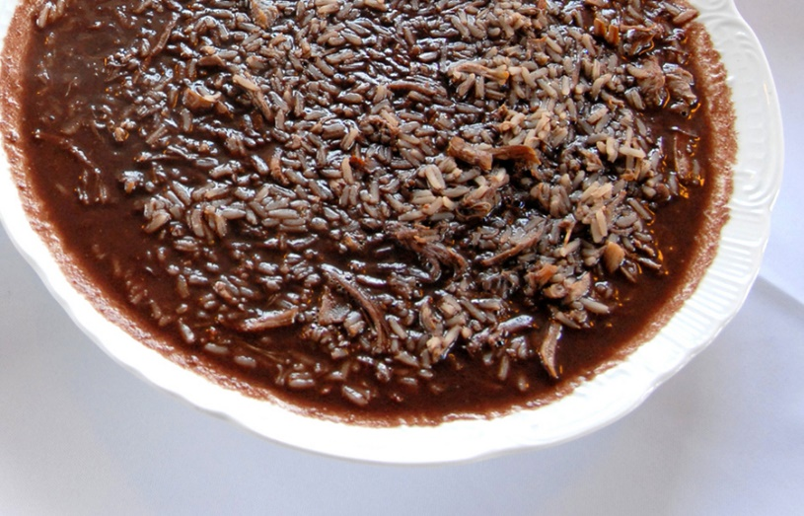
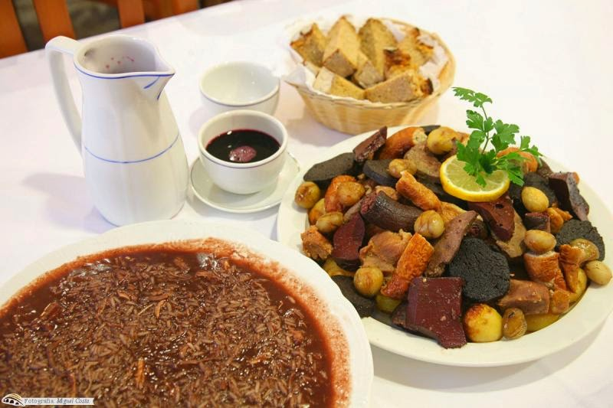
Arroz de sarrabulho
Arroz de Sarrabulho is a very unique and traditional meat and rice stew dish in Portuguese gastronomy, originating in the northern region of Portugal, Minho. Parts of the pork are cut into small pieces, which are spiced and marinated in cumin and red wine and then cooked in pigs’ blood. This dish is not for the faint hearted and has some of the most unique flavors in Portuguese cuisine. This recipe is a slightly easier and a more simple variation than the original. Arroz de Sarrabulho is typically accompanied best with some bread for dipping

Slide 3
Ingredients
1/2 lbs. beef short ribs
1/2 lbs. pork chops
1/2 cup pork’s blood
1 tablespoon wine vinegar
1/3 lbs. Chouriço
1 bay leaf
Salt and pepper to taste
1 teaspoon nutmeg
2 cloves
1 teaspoon cumin
1 cup rice
1 teaspoon lemon juice
1 lemon sliced thinly

Slide 4
Directions:
In a large saucepan add all the meats (short ribs, pork chops, chouriço), 5 cups water, salt and pepper to taste, nutmeg, cloves and bay leaf. Bring it to a boil.
When the meat is cooked remove from the heat. Allow to cool slightly. Remove the meat into a bowl and then shred it into small pieces with a knife.
Remove the excess fat pieces and add them to the saucepan with the broth. In the broth add the rice and let it cook slowly on medium-low heat.
When the rice is half cooked add the meat shreds and the pig’s blood mixed with the wine vinegar and simmer until the rice is fully cooked. Add the lemon juice, cloves, and cumin powder and stir well.
Let it simmer for 5 minutes on low heat.
Pour into a large serving bowl and cover with the sliced lemon and serve while hot with bread on the side for dipping.

Slide 5
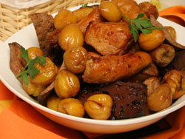
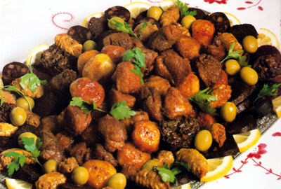
Rojões à moda do minho
Portuguese is one of the most appreciated dishes of the Portuguese gastronomy that no one resists.
In ancient times Portuguese Cooked or cooked in Portuguese was prepared with leftovers, so there are several versions of its recipe. The one I bring you here is in my family for generations and it differs from the majority of the other recipes because we boil beef and sausages apart from the pork meats these are too greasy for our taste. If you prefer, you may boil all the meats together.

Slide 6
Ingredients
6 dl dry white wine
5 chopped garlic cloves
1 tbsp paprika
1 tbsp ground cumin
1.5 kg cubed pork leg
2 bay leaves
4 tbsp olive oil
salt and pepper to season

Slide 7
Instructions
Prepare a marinade with the wine, chopped garlic, paprika, half the cumin, salt and pepper. Add the meat to this marinade and leave overnight.
Remove the meat from the marinade and lightly fry the pork cubes on the olive oil, previously heated.
When the meat has a golden color, add the marinade along with the bay leaves, letting it cook slowly until the meat is tender.
Sprinkle with the remainder of the cumin before serving this rojoes recipe that goes well with French fries cuted into cubes or white rice.

Slide 8
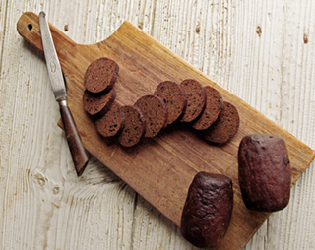
Work done by:
Alcino Monteiro Nº2
Nelson Fontes Nº16

