Slide 1
Brasilian Food
Leste de Minas Gerais

Slide 2
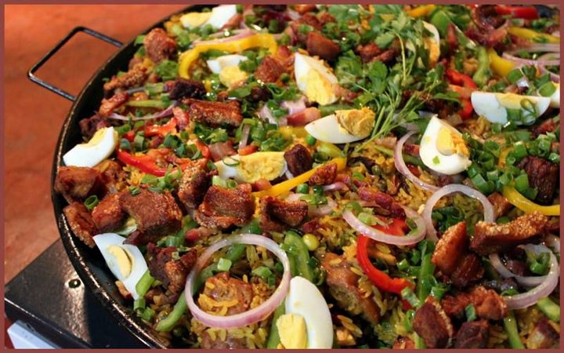
Feijão Tropeiro
A recipe that has appeared in the sixteenth and seventeenth centuries, popularized by the bandeirantes and tropeiros, the tropeiro beans, one of the most traditional dishes of Brazilian cuisine, carries some main ingredients such as beans, cassava flour and meat, usually porc. And because it is an easy and quick recipe, over time it has been adapted in several regions of the country.

Slide 3
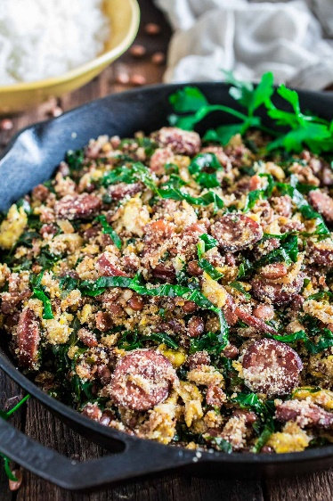
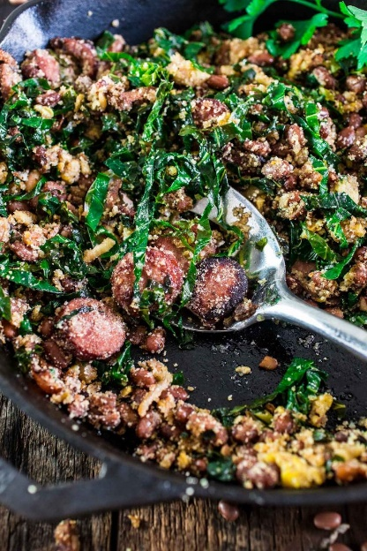
The variations of this recipe are diverse and each version brings some special ingredient that makes the recipe even more delicious and characteristic. This dish is so good that it can be eaten alone, accompanied by rice or even along with barbecue.

Slide 4
Ingredients
2 kg of pork loin;
1 kg toasted cassava flour;
Garlic;
1 chopped onion;
500 g of chopped bacon;
Parsley or coriander to taste;
2 kg of beans;
Salt to taste;
1 pinch of sugar.

Slide 5
Preparation Mode
Preparation Mode
Put the beans on the stove to cook;
In a casserole, fry the bacon. Reserve;
Make a paste with the garlic and the salt and season the meat cut into mincemeat;
Fry the onion with the fat of the bacon. Put some sugar and let it flush;
Add the meat and fry;
After the meat is fried, add the cooked beans, the greens, the minced herbs, and finally the cassava flour, always stirring with a wooden spoon until the mixture is thick;
Let it simmer a few minutes before turning it off.
Serve the tropeiro beans with rice or with barbecued meat.

Slide 6
Brigadeiro
The brigadeiro, one of the most famous sweets in the world, was of Brazilian origin and its creation resulted from quite original circumstances.

Slide 7
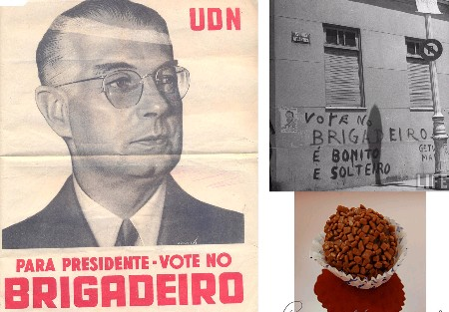
…
In 1945, shortly after the end of World War II, Brazil was in campaign time for the election of a new president. The candidate Eduardo Gomes, whose military rank was Brigadier (Brigadeiro), had enormous success among women, which was evidenced by his slogan of the campaign that was "Vote in the Brigadeiro that is beautiful and single."

Slide 8
Ingredients
Preparation Mode
1 tin of condensed milk
1 tablespoon unsalted margarine
4 tablespoons chocolate powder
granulated chocolate
In a deep saucepan, add the condensed milk, margarine and chocolate powder
Cook over medium heat and stir until the brigadeiro starts to loosen off the pan
Let it cool and make small balls with the hand passing the dough in granulated chocolate

Slide 9
Credits to:
Vitória Gabrielly Vieira Catalde
Paula Margarida Queirós
Class: TRB
Teacher: Alexandra Ferreira Lopes/Isabel Costa

