Slide 1
Inglês Aplicado Restauração
Luana nº12
Diana nº5
Vitor nº19

Slide 2
Cocktail

Slide 3
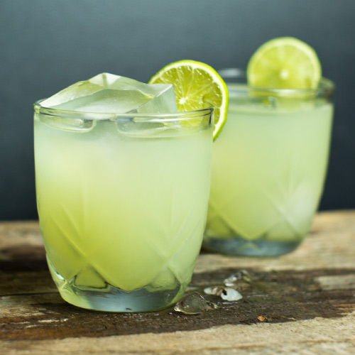
Margarita
Ingrédients:
1 part Cazadores Tequila
½ part triple sec liqueur
½ part lime juice
1 lime wedge
Salt
How to mix:
-Chill your glass (the easiest way is to fill it with ice)
-Put lots of ice and all of the ingredients into a shaker, then shake hard for about 30 seconds to chill the liquid really well
-Run a lime wedge around the outside of the rim of your glass before rolling the rim in salt
-Double strain the mix into the glass

Slide 4
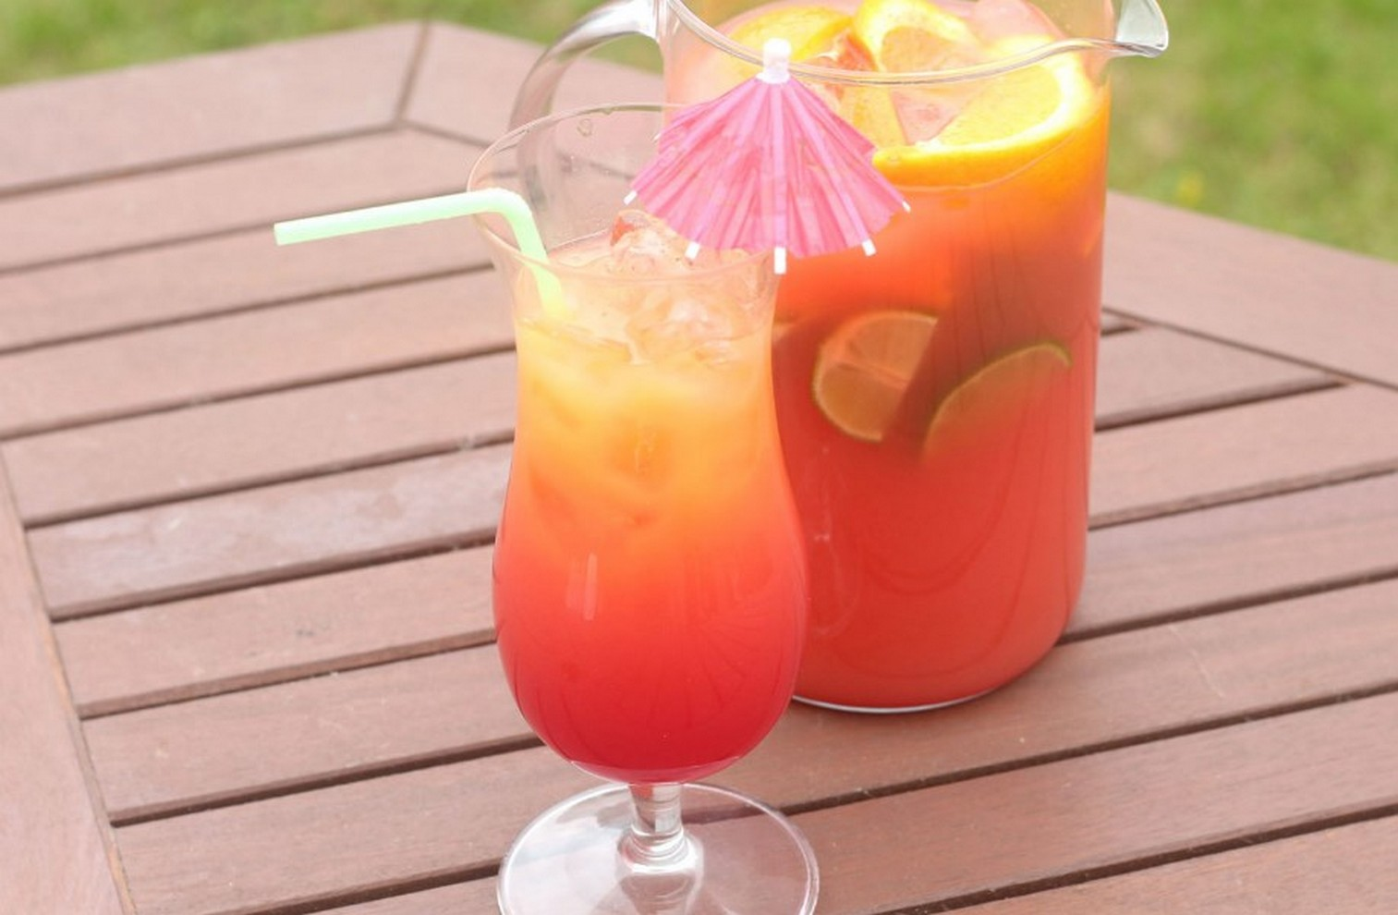
Mimosa
How to mix:
-Pour the juices, rum, sugar syrup, grenadine and Angostura bitters into a large jug and give it a good stir. Pop into the fridge to chill for 1 hr.
-Serve over ice cubes, sprinkle over the nutmeg and garnish with an orange slice and maraschino cherry, speared with a cocktail stick.
Ingrédients:
-175ml freshly squeezed orange juice
-75ml freshly squeezed lime juice
-150ml good-quality golden rum
-50ml sugar syrup
-dash of grenadine syrup
-dash of Angostura bitters
-ice cubes, to serve
-generous pinch of freshly grated nutmeg
-2 thick slices orange
-maraschino cherries

Slide 5
Smoothies

Slide 6
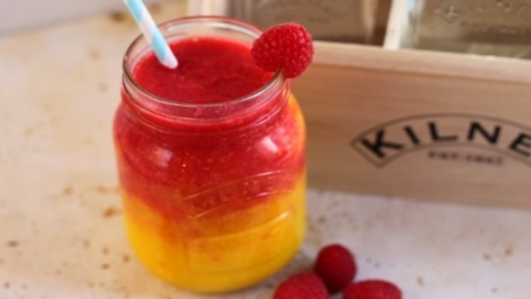
Tropical Raspberry Ombré
Ingredients:
-1 whole pineapple, peeled, cored and eyes removed, chopped into chunks
-1 whole ripe mango, peeled, stoned and chopped into chunks
-125g water
-250g raspberries
-Ice
Method:
-Blend the pineapple, mango, a few ice cubes and water until smooth. Pour into a Kilner mug, filling it half way.
-Blend the raspberries and ice until smooth. Pour on top of the tropical mixture and swirl with a straw.

Slide 7
Oreo Smoothie

Slide 8
The End

